Slide 1
Avionics, GNC and SW Systems Review for LEAPFROG GEN II
Requirements:
  LEAPFROG GEN II Flight Requirements
  Avionics Requirements
  GNC Requirements
  Software Requirements
System Overview and Architecture Definition
  Top Level Performance Specs
  Avionics
  Power system
  GNC Specifics
System Details
  Avionics Details
  GNC Details
  Software Details
Competition Simulation and Flight Operation Definitions
Notes:
Add abort codes or mission variables, test scenarios..

Slide 2
Primary Flight Requirements for LEAPFROG
Flight Goals:
  >2.5 meters in height
  10 second to 60 second max flight duration
  Stability in roll, pitch, and yaw during hover and translation (+/- 0.5 deg)
  Control over altitude (+/- 0.5 meter)
  Active abort contingencies
Off-Board Goals:
  Ground control authority
  Command override authority during flight from Ground
  Turnaround of LEAPFROG flight to flight within 15 minutes
  Analysis of accuracy and efficiency of system components
Notes:
Add abort codes or mission variables, test scenarios..

Slide 3
Gen II Avionics Requirements
Hardware Requirements
  Sensors for Stabilization, attitude control, and navigation
  Processor for multiple GNC algorithm systems
  Telemetry system for downlink of real time flight data, and uplink “heartbeat” for safety override
  Engine Controller for Jet Engine
  Relay Controller for ACS Thrusters
  Sufficient Power system for all primary and secondary devices, with sufficient margin for Flight
Software requirements
  Ground Operations Mode for startup, checkout, and override
  Mission Mode (flight profile insertion, autonomous flight, safety overrides)
  Flight Information (health and safety and status of all systems)

Slide 4
GNC Requirements
Establish two methods to support Stabilization and Translation for LEAPFROG
  Primary Stabilization through Cold Gas Thrusters as Attitude Control
  Primary Translation using Thrust Vector Control (TVC) with a gimbaled Jet Engine
Each operates independent of the other, but each can provide for some level of stability in emergencies
For the Simulation and Flight Challenge, competitors will only program inputs to the TVC and Engine system
  The ACS system is independent and meant to be failsafe

Slide 5
Software Requirements
TBD

Slide 6
System Architecture
Full Systems Functional Layout
Power System Functional Layout
GNC System functional Layout
Etc
Must combine the following charts into something that is consistent with each other, and makes it easy to trace from hardware, to function etc.

Slide 7
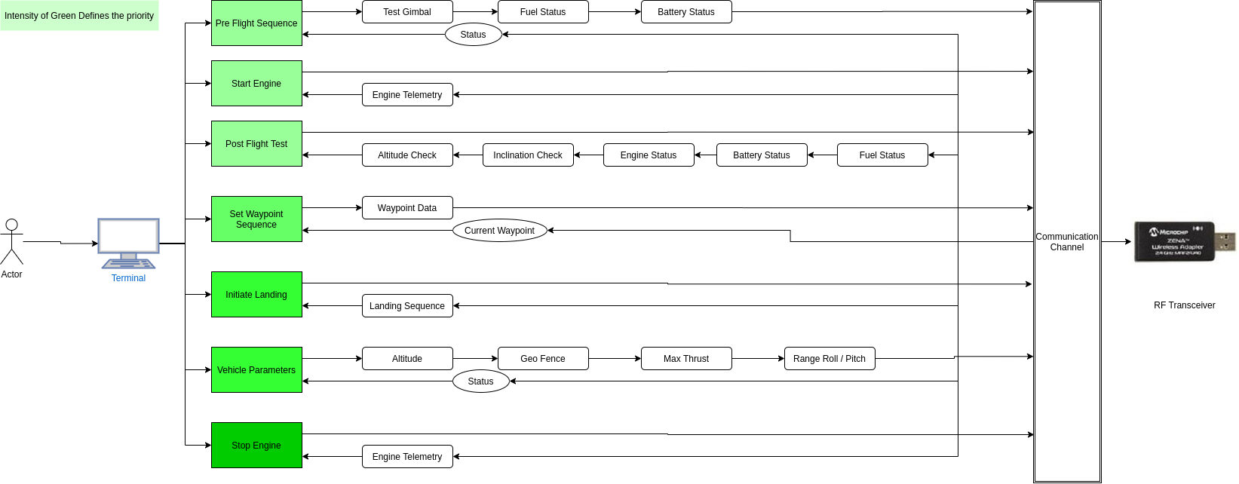
Ground Station Layout

Slide 8
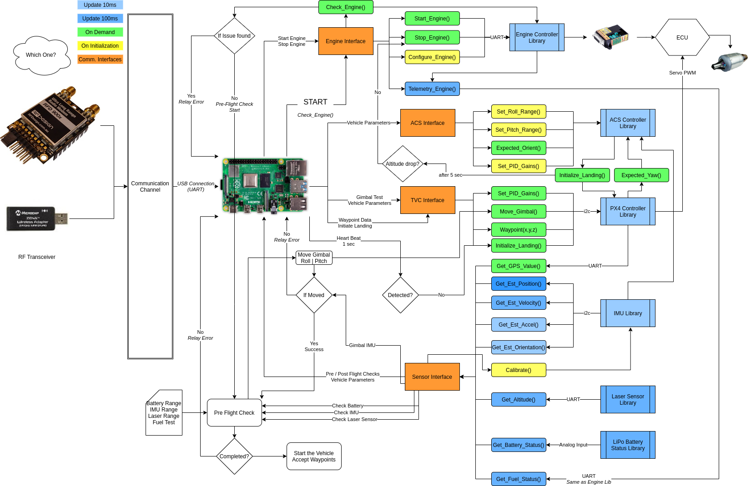
Vehicle Layout

Slide 9
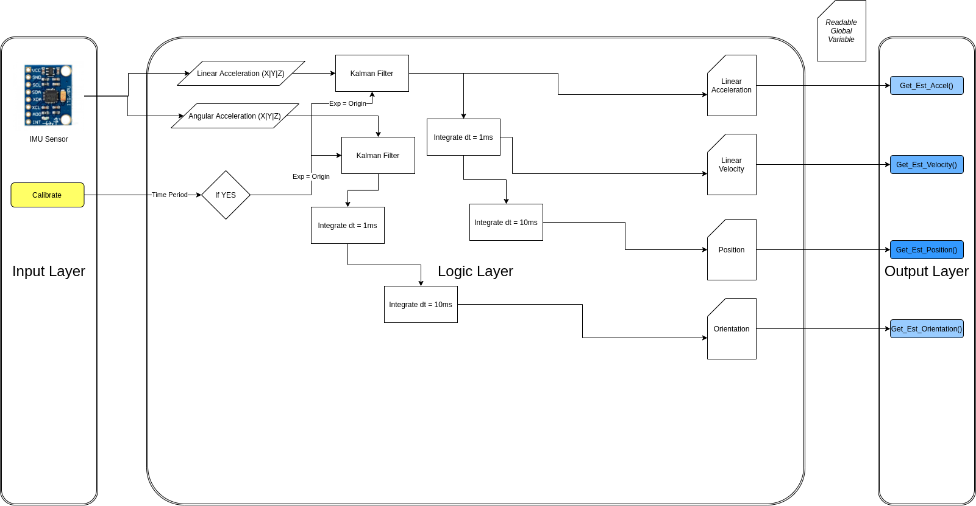
IMU Sensor Logic

Slide 10
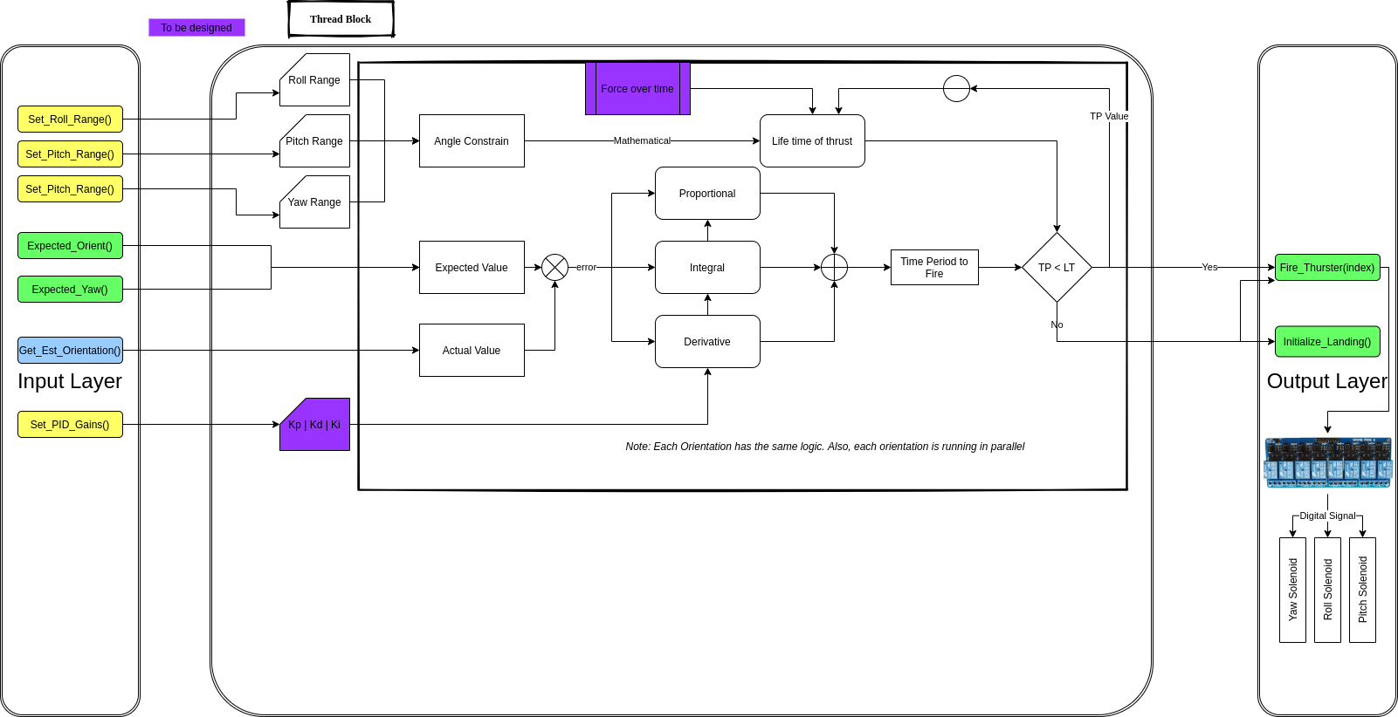
ACS Control Logic

Slide 11
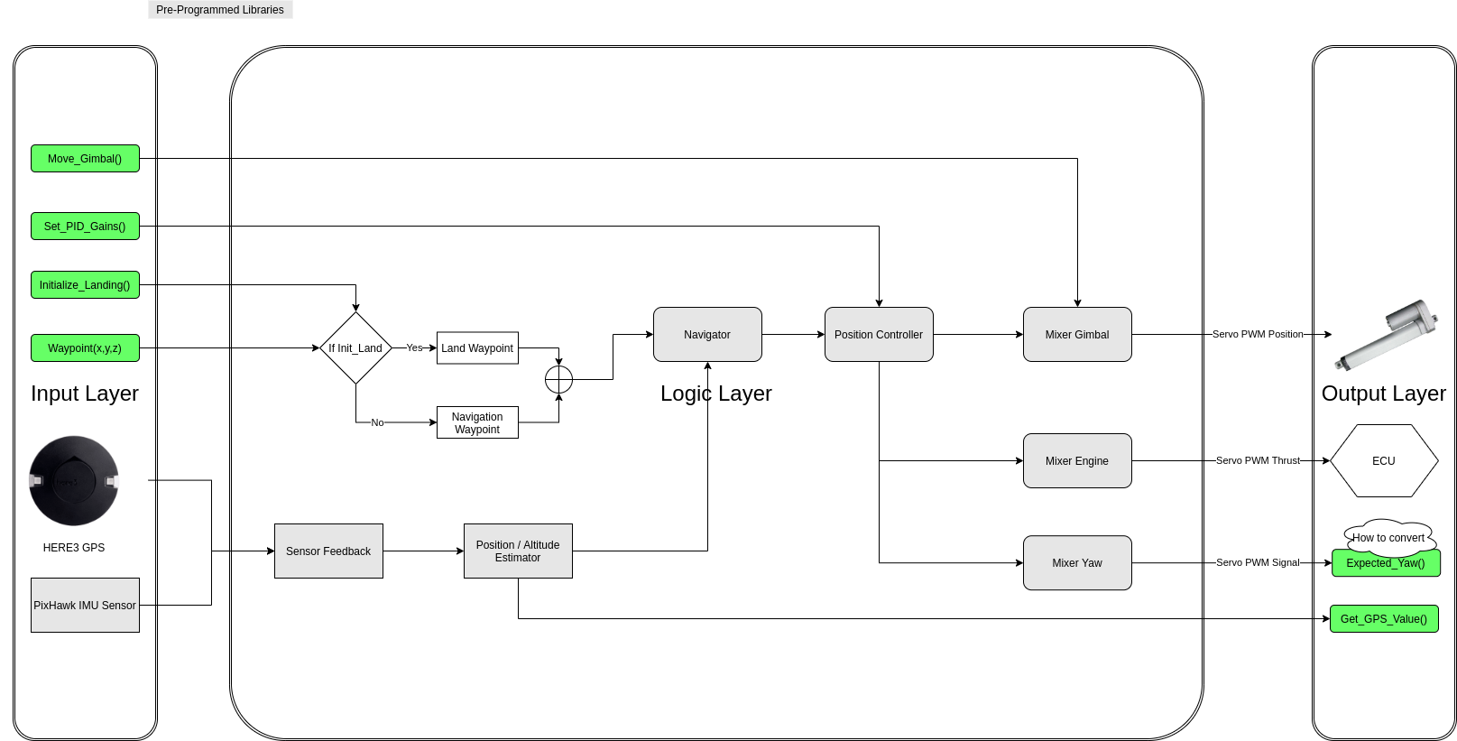
TVC Control Logic

Slide 12
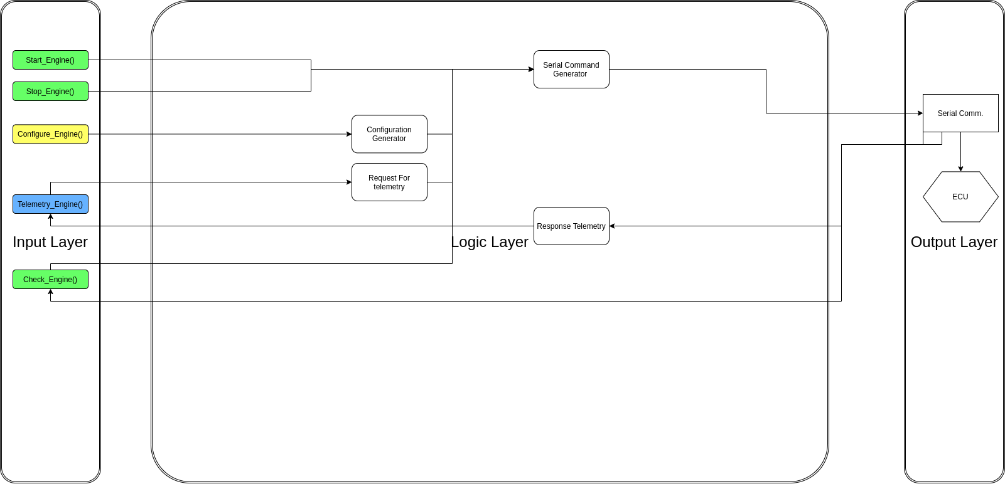
Engine Interface Logic

Slide 13
TVC Control Logic

Slide 14
TVC Control Logic

Slide 15
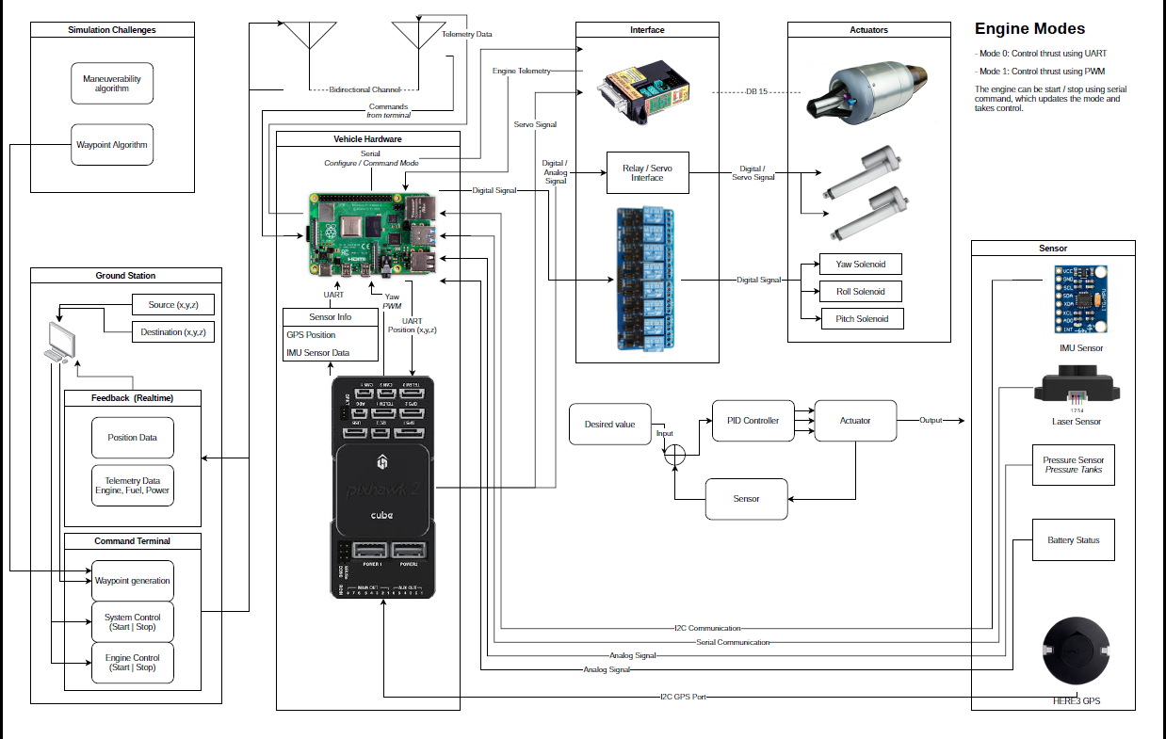
System Block Diagram

Slide 16
Ground
Power
Lander
LiIon Charger
Power Distribution Unit
C&DH
ACS
586D Controller
D/A Board
12 PLC or Relays
12V
P/L
Solenoids
22V
Ground Power
Camera
P/L
Cam Antenna
Comm
Ground Computer
(Thinkpad)
Camera Interface
Wireless
H&S Antenna
GNC
5V
Payload Antenna
3 MEMS Gyros
Payload Antenna
3.3V
H&S Antenna
3 MEMS Accels
Jet Prop.
4 Gimbal Motors
5V
Altimeter
9V
Fuel Shutoff
12V
Ground Jet
Controller
ECU
Propane Shut off
Jet Pump
Jet Engine
Kristina Rojdev
Dec 03, 2007

Slide 17
Software Architecture
TBD

Slide 18
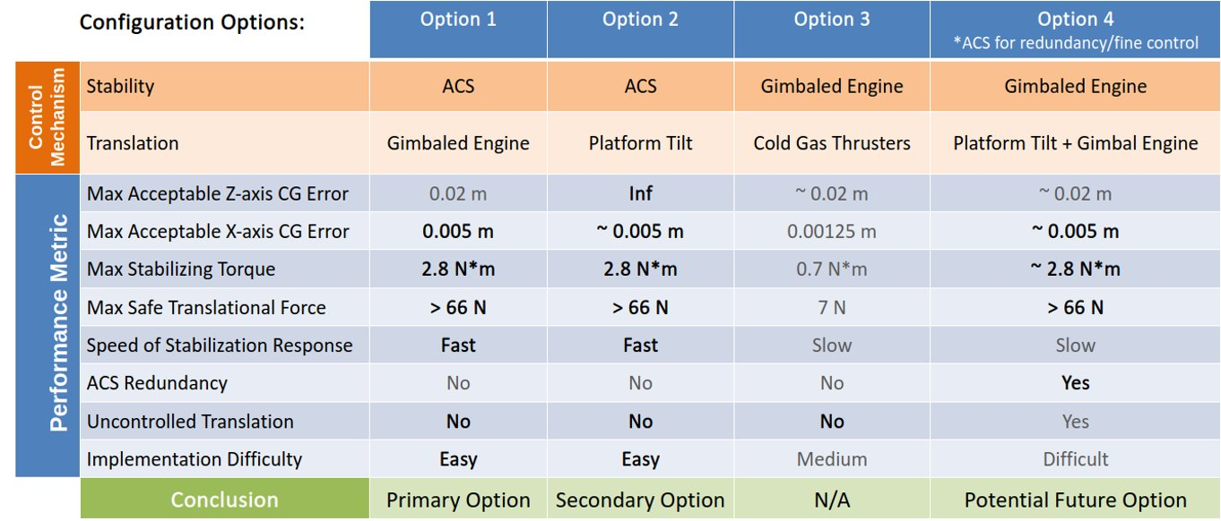
Configuration Comparison

Slide 19
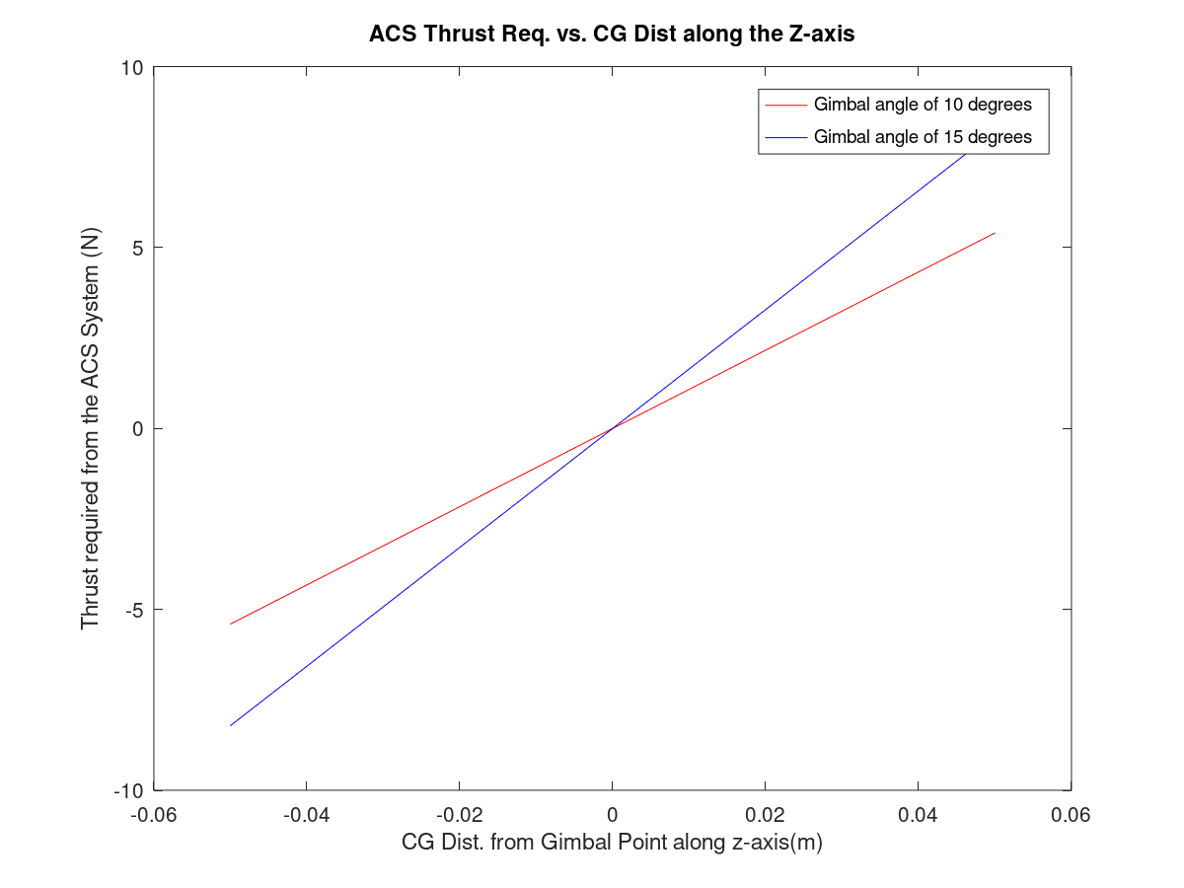
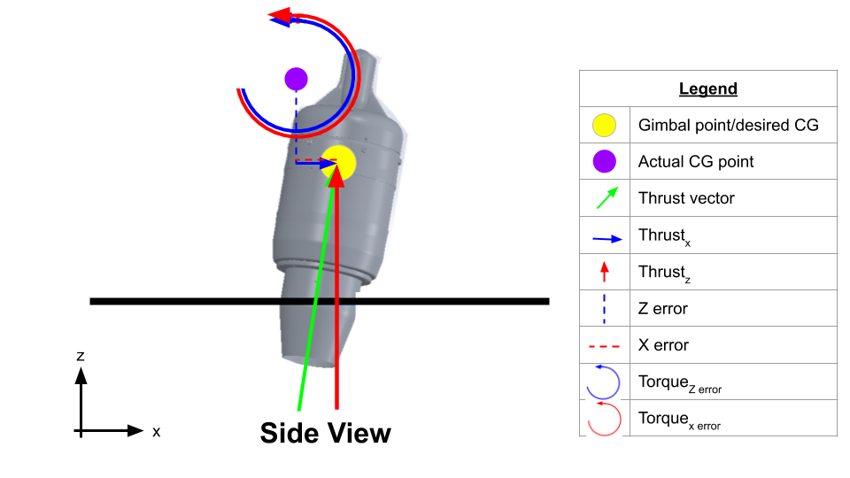
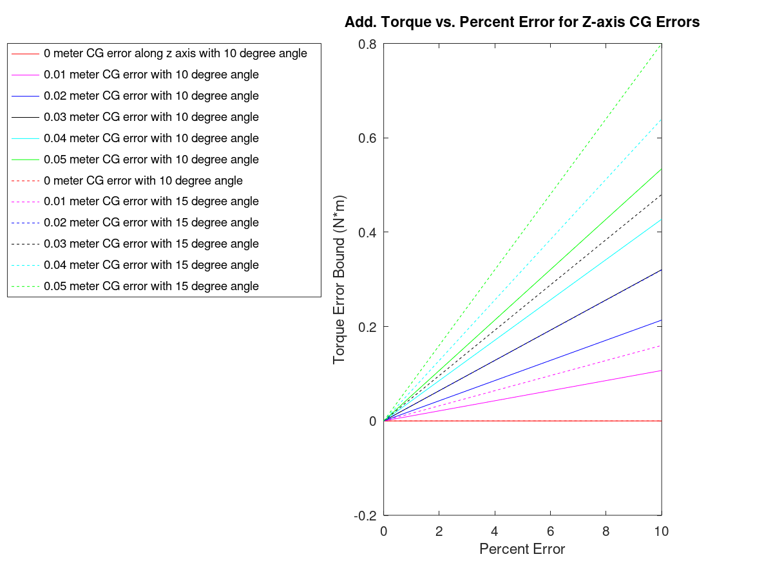
Configuration Comparison
Link to full document: https://docs.google.com/document/d/1CP5_ekTFtuK3u4mSZqckigZ51Cf-EMv6XL89iKFO6wk/edit

Slide 20
System Overview
ACS
ODRIOD
Solenoid
Feedback Sensors
ACS Controller
Pitch
Roll
Demodulator
Yaw
TVC
Pixhawk Cube
PX4
Gimbal
Pos/Att Estimator
ECU
Jet Engine
Navigator
Position Controller
Mixer

Slide 21
TVC
Ground Control Station
QGroundControl
People/Path Planning Software
Legend For Arrows:
Waypoints/constraints/parameters
Sensor/position feedback
Position setpoints
Attitude and thrust setpoints
Thrust setpoint
Commands for actuators
Feedback Sensors
Pixhawk Cube
PX4
Gimbal
Pos/Att Estimator
ECU
Jet Engine
Navigator
Position Controller
Mixer

Slide 22
Links:
Documentation for uploading the firmware onto the vehicle: https://docs.px4.io/master/en/config/firmware.html
PX4 Controller Diagrams: https://dev.px4.io/master/en/flight_stack/controller_diagrams.html
Estimation/Localization library documentation: https://docs.px4.io/master/en/advanced_config/tuning_the_ecl_ekf.html

Slide 23
ACS
ODRIOD
Feedback Sensors
Solenoid
ACS Controller
Pitch
Roll
Pixhawk
Demodulator
Yaw
PX4
Legend For Arrows:
Sensor feedback
Duty cycle for pitch and roll cold gas thrusters/relays/solenoids
PWM corresponding to the yaw force desired
Duty cycle for yaw cold gas thrusters/relays/solenoids

Slide 24
ACS
ACS Controller
Standard PID Controller With Low-Pass Filter on D Term
Force to Duty Cycle Conversion Estimator
Attitude Feedback
Duty Cycle

Slide 25
Power System layout
Jet Engine
24V
Relays
12 solenoids
Camera
7.2V
Avionics Computer
Opto-isolator
D/A
Power Amp
Gimbal Motors
IMU
LDO regulator
Altimeter
6V
Red lines are power lines and black lines are signal lines. Ground and voltage lines have not been specified.

Slide 26
Detailed Systems Definitions
Avionics & Wireless System
GNC & Engine
Power
Note what follows are examples of the kind of information that should be included in various sections

Slide 27
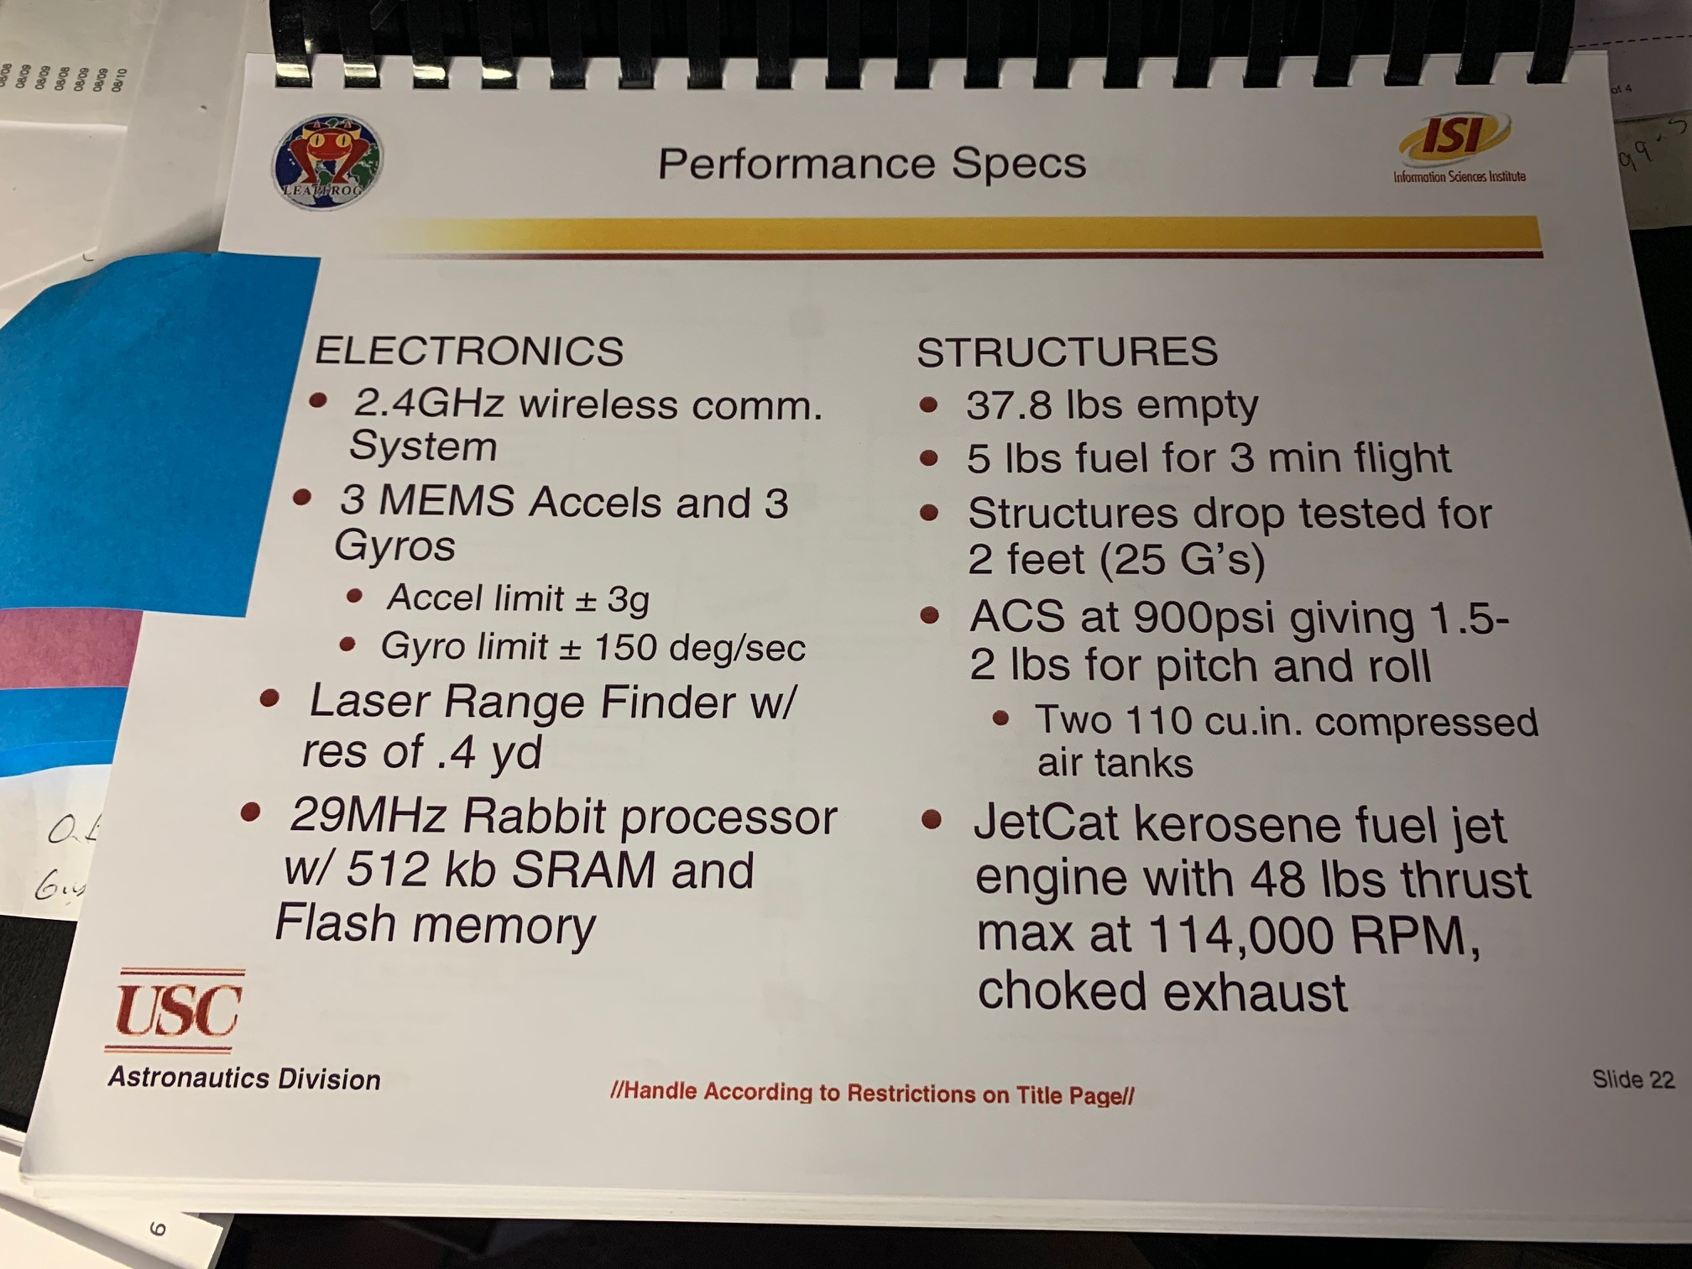
Top Level Performance Specs (can be actual hdwe specs or not)

Slide 28
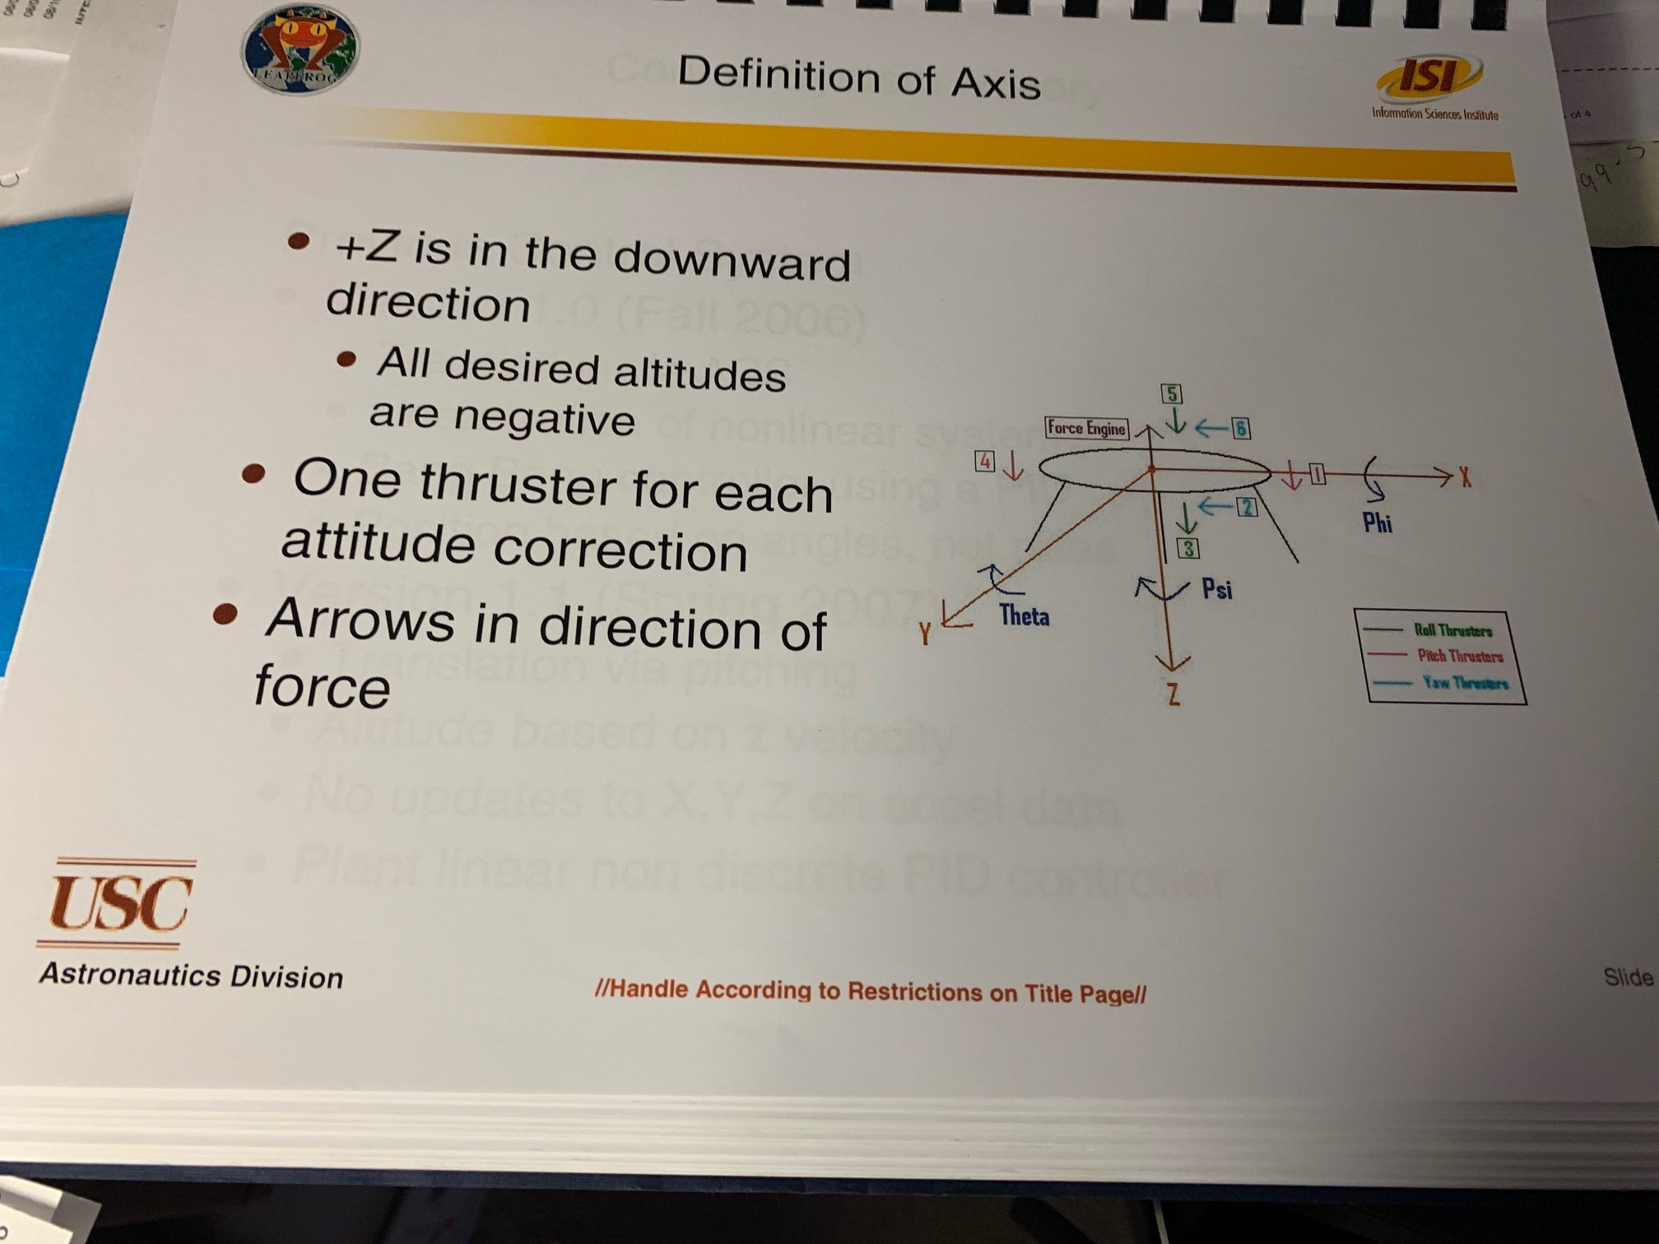
Common Flight Axes definitions for Code and hdwe orientation

Slide 29
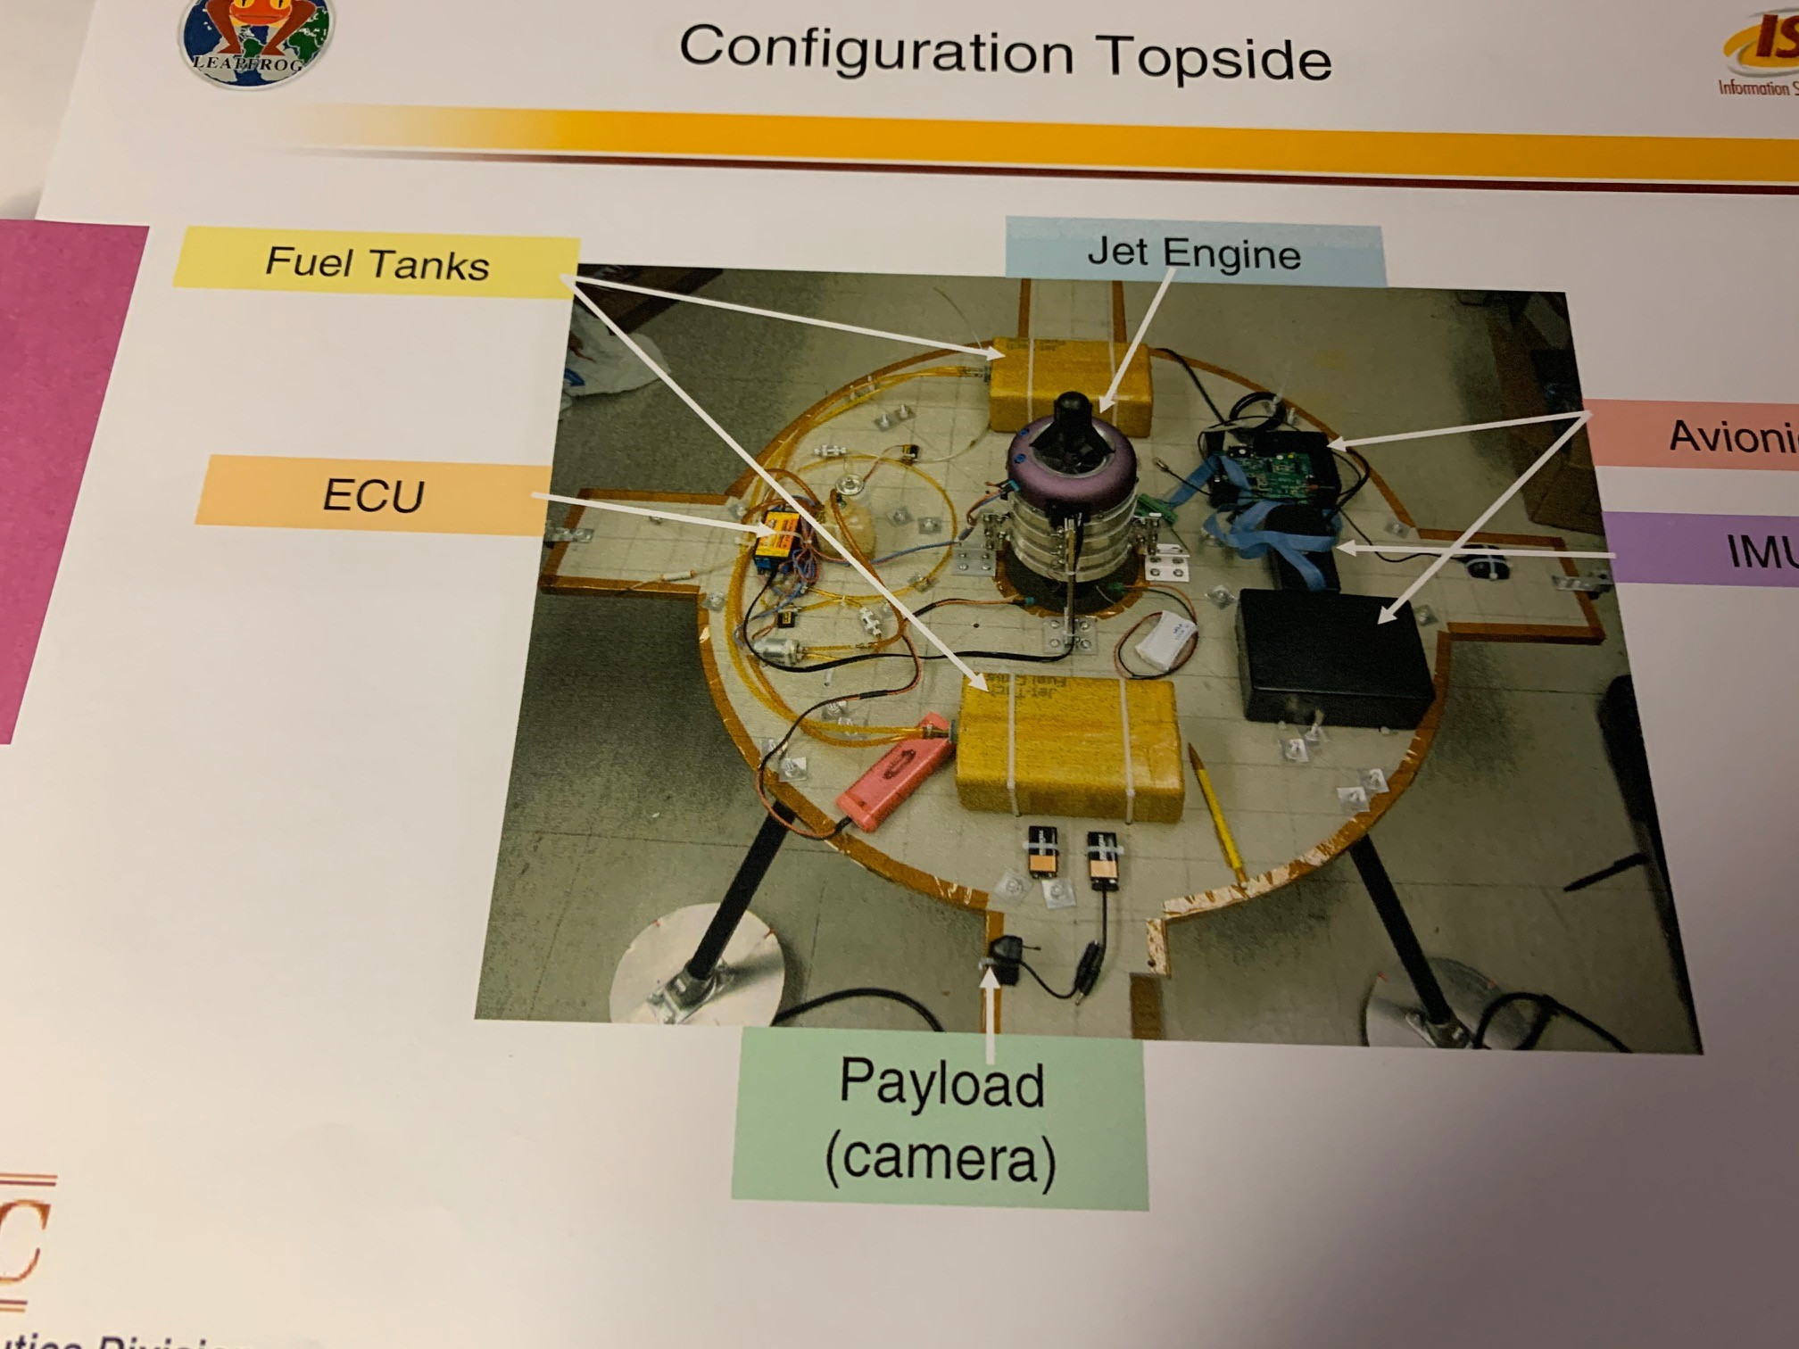
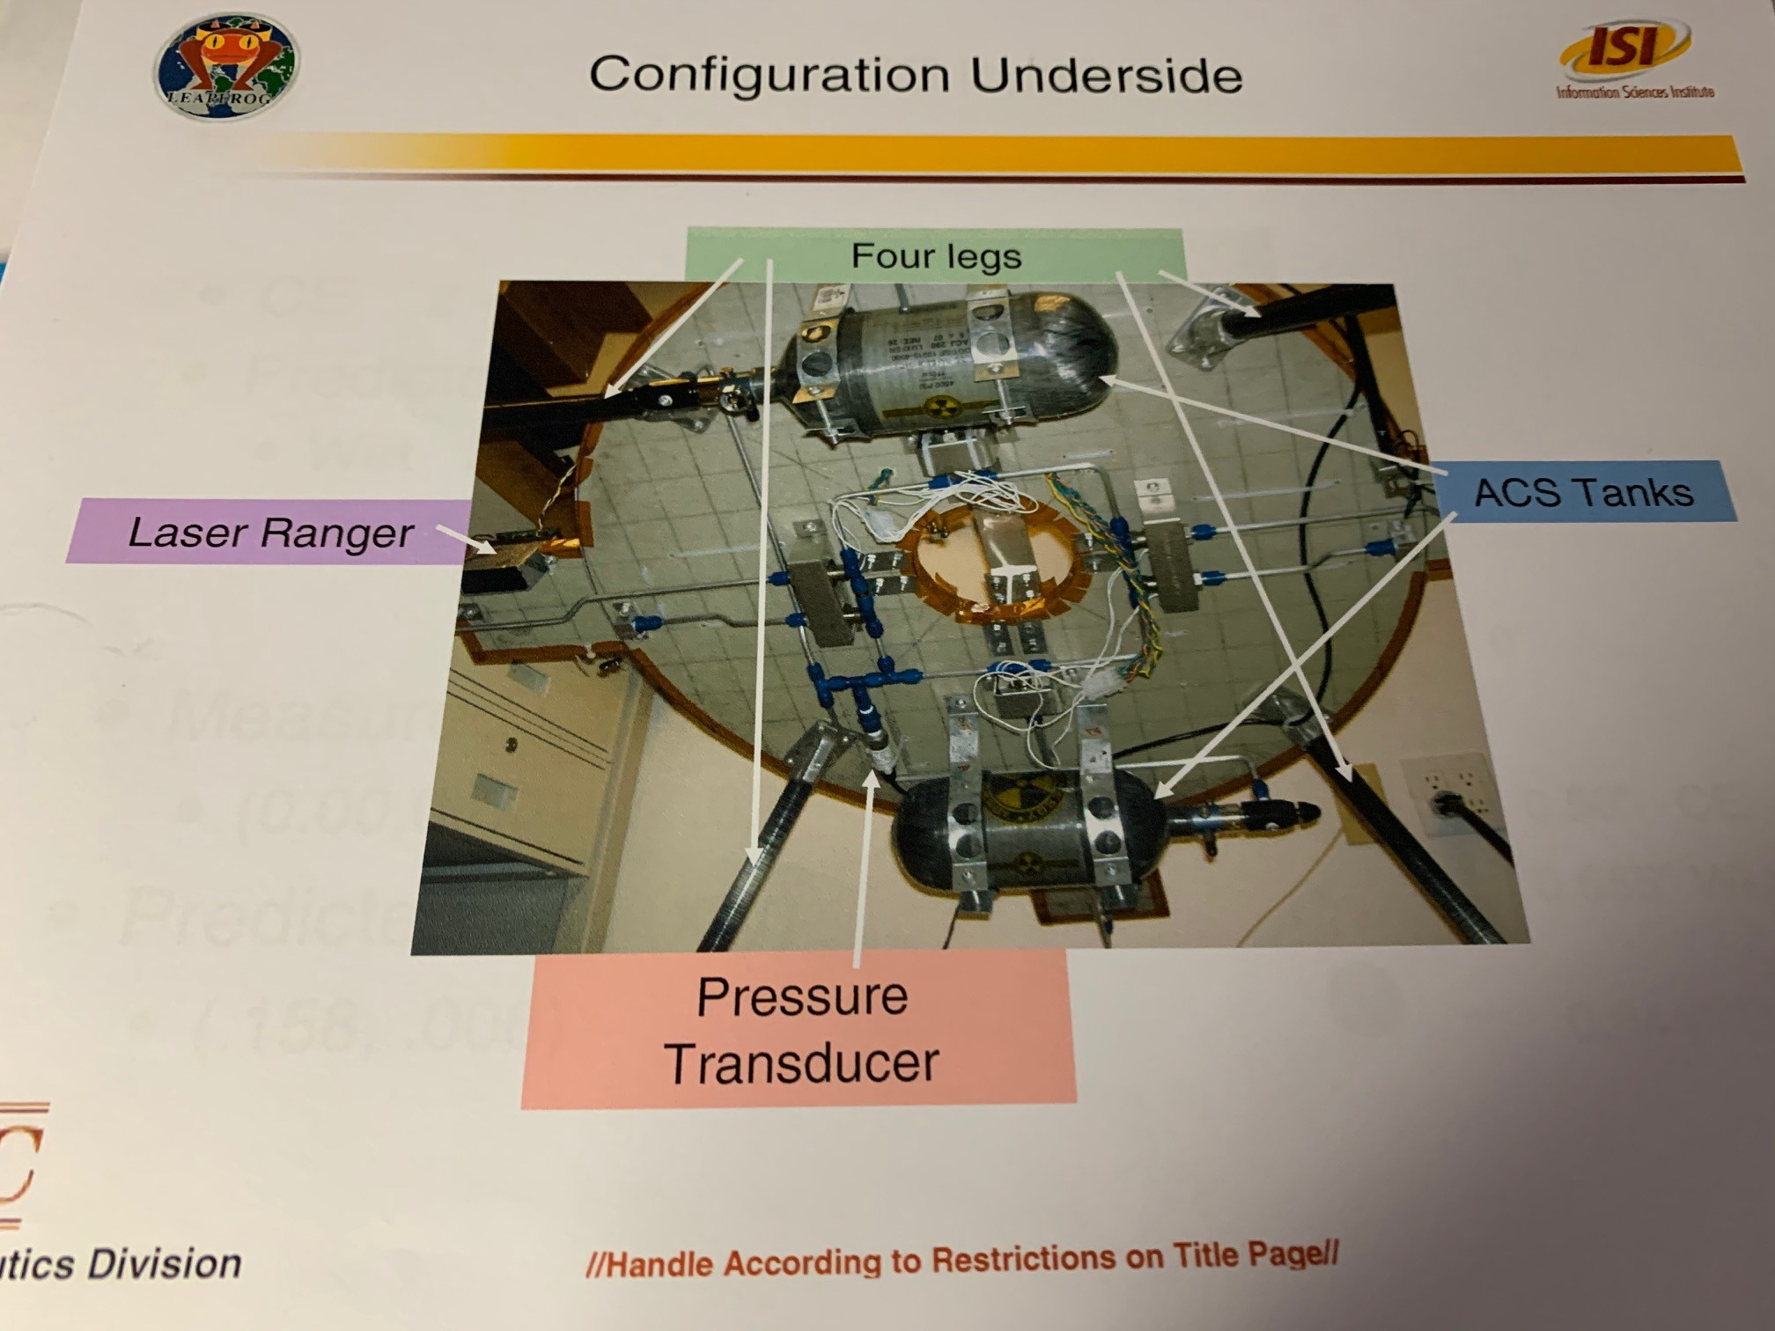
Layout of Hardware (either actual photo or CAD, doesn’t matter

Slide 30
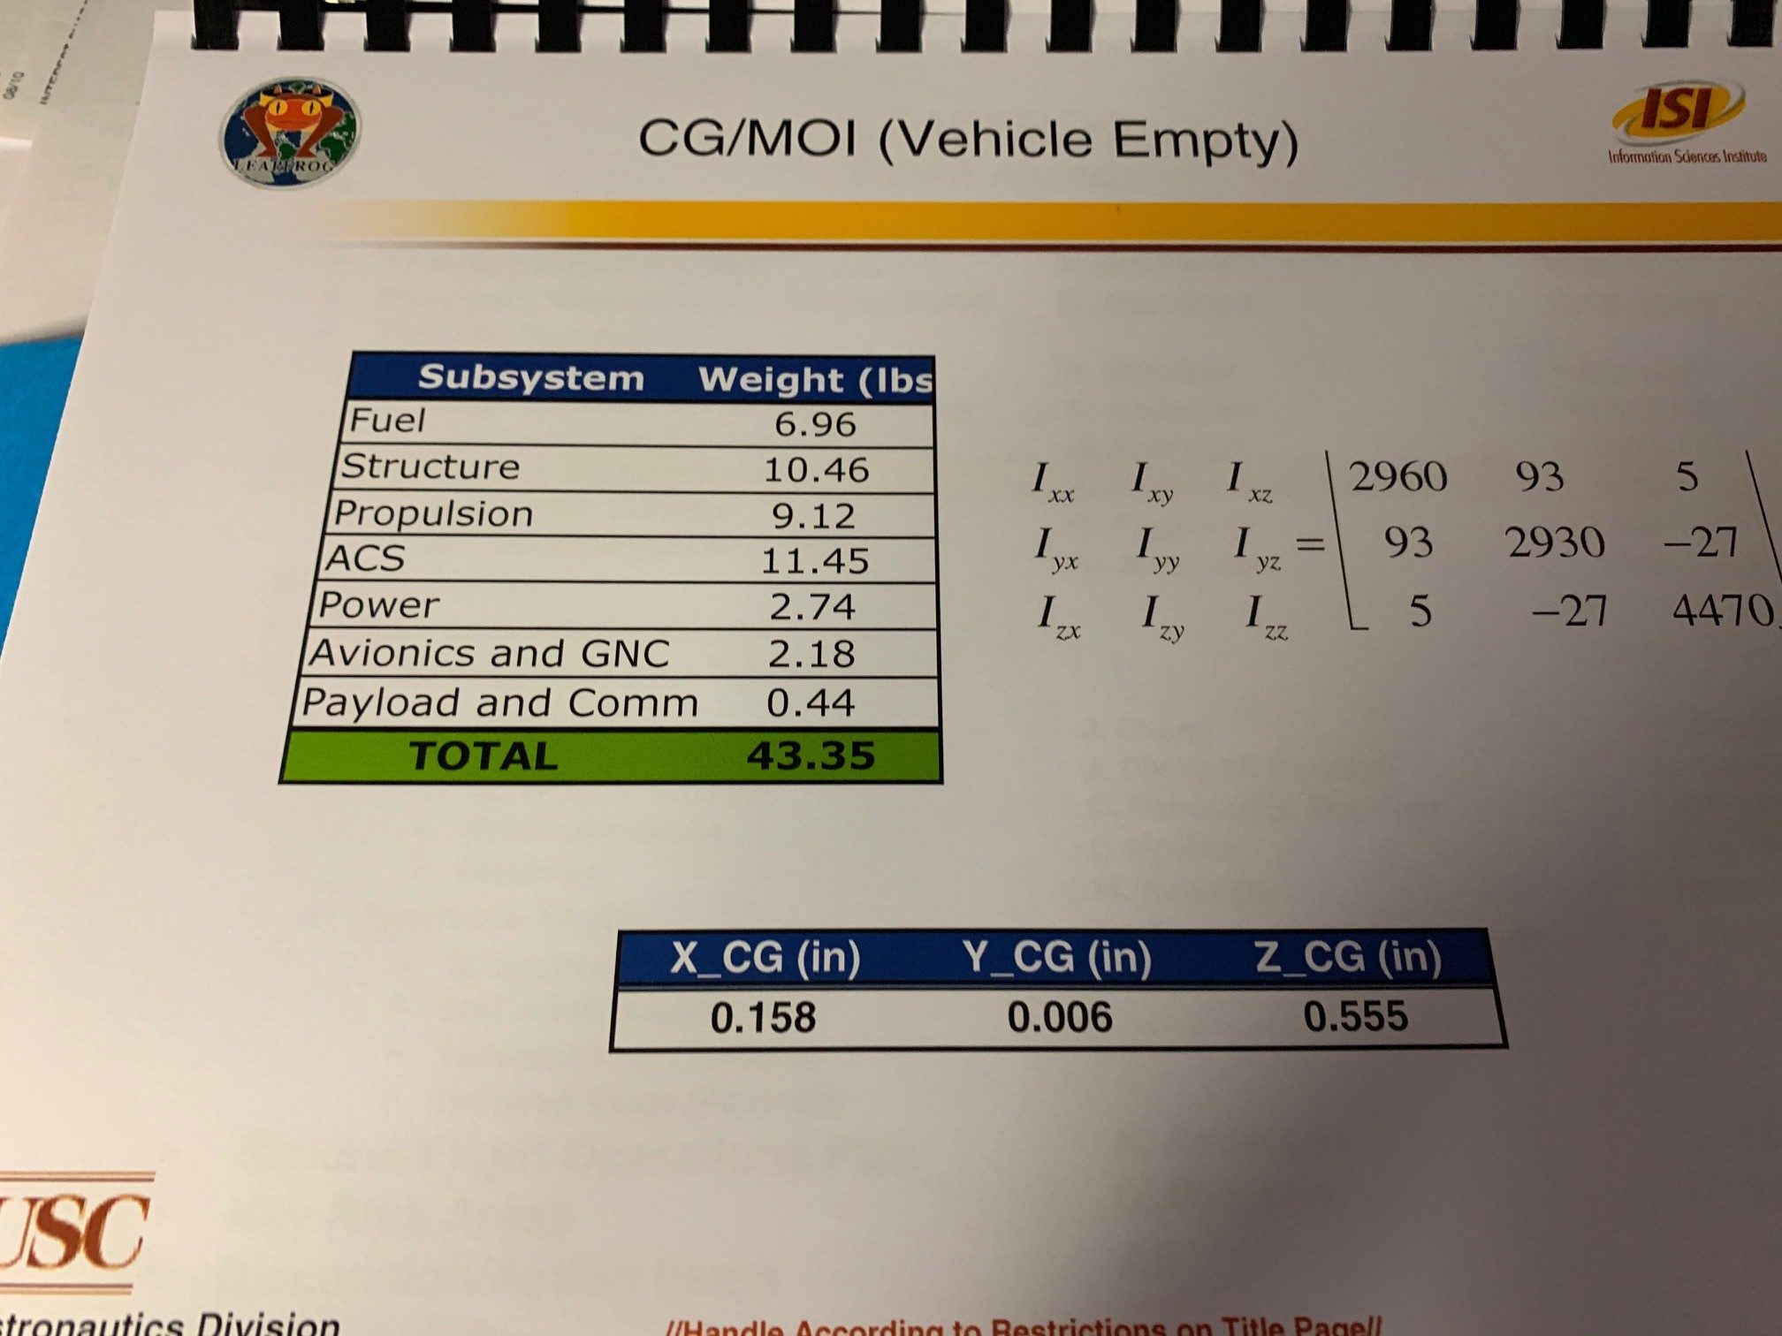
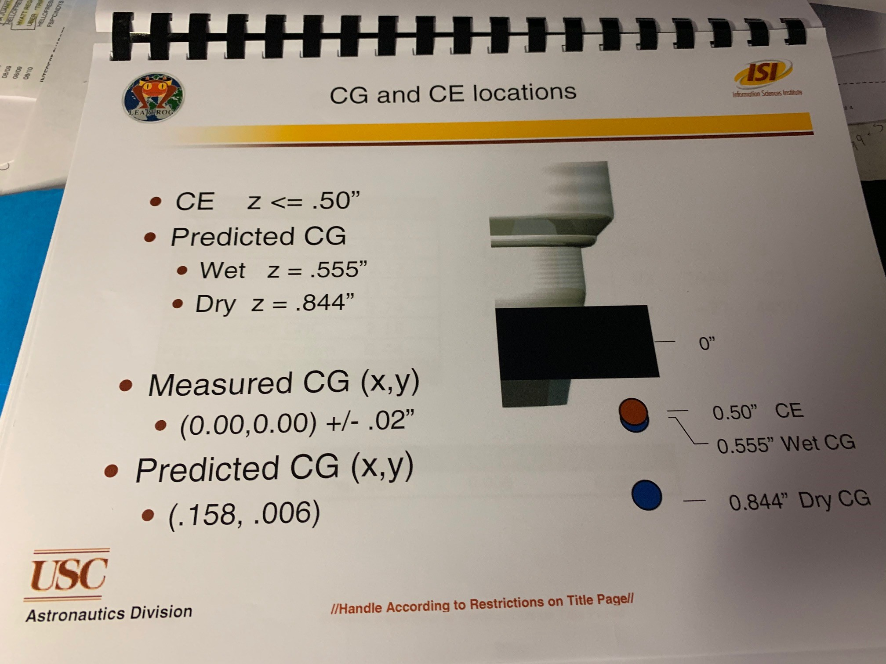
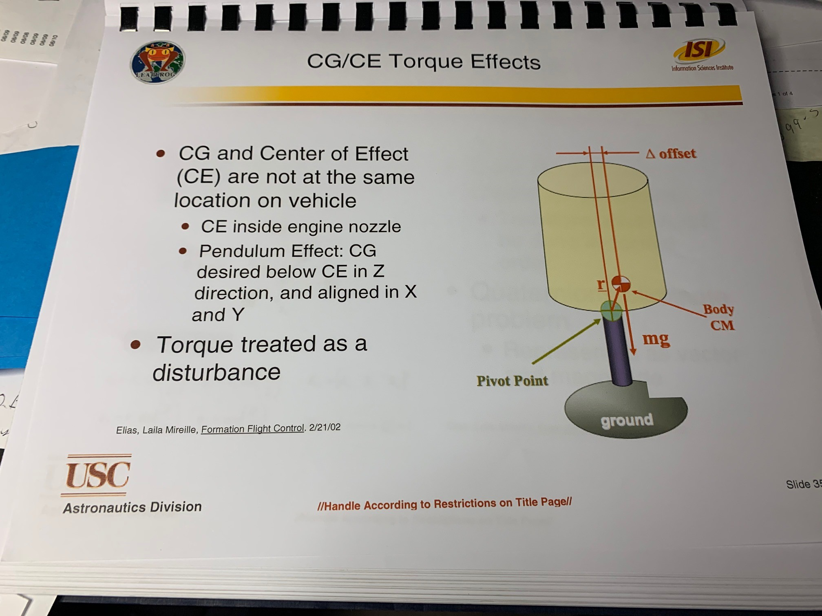
Define CG/MOI/CE Location/Effectos etc

Slide 31
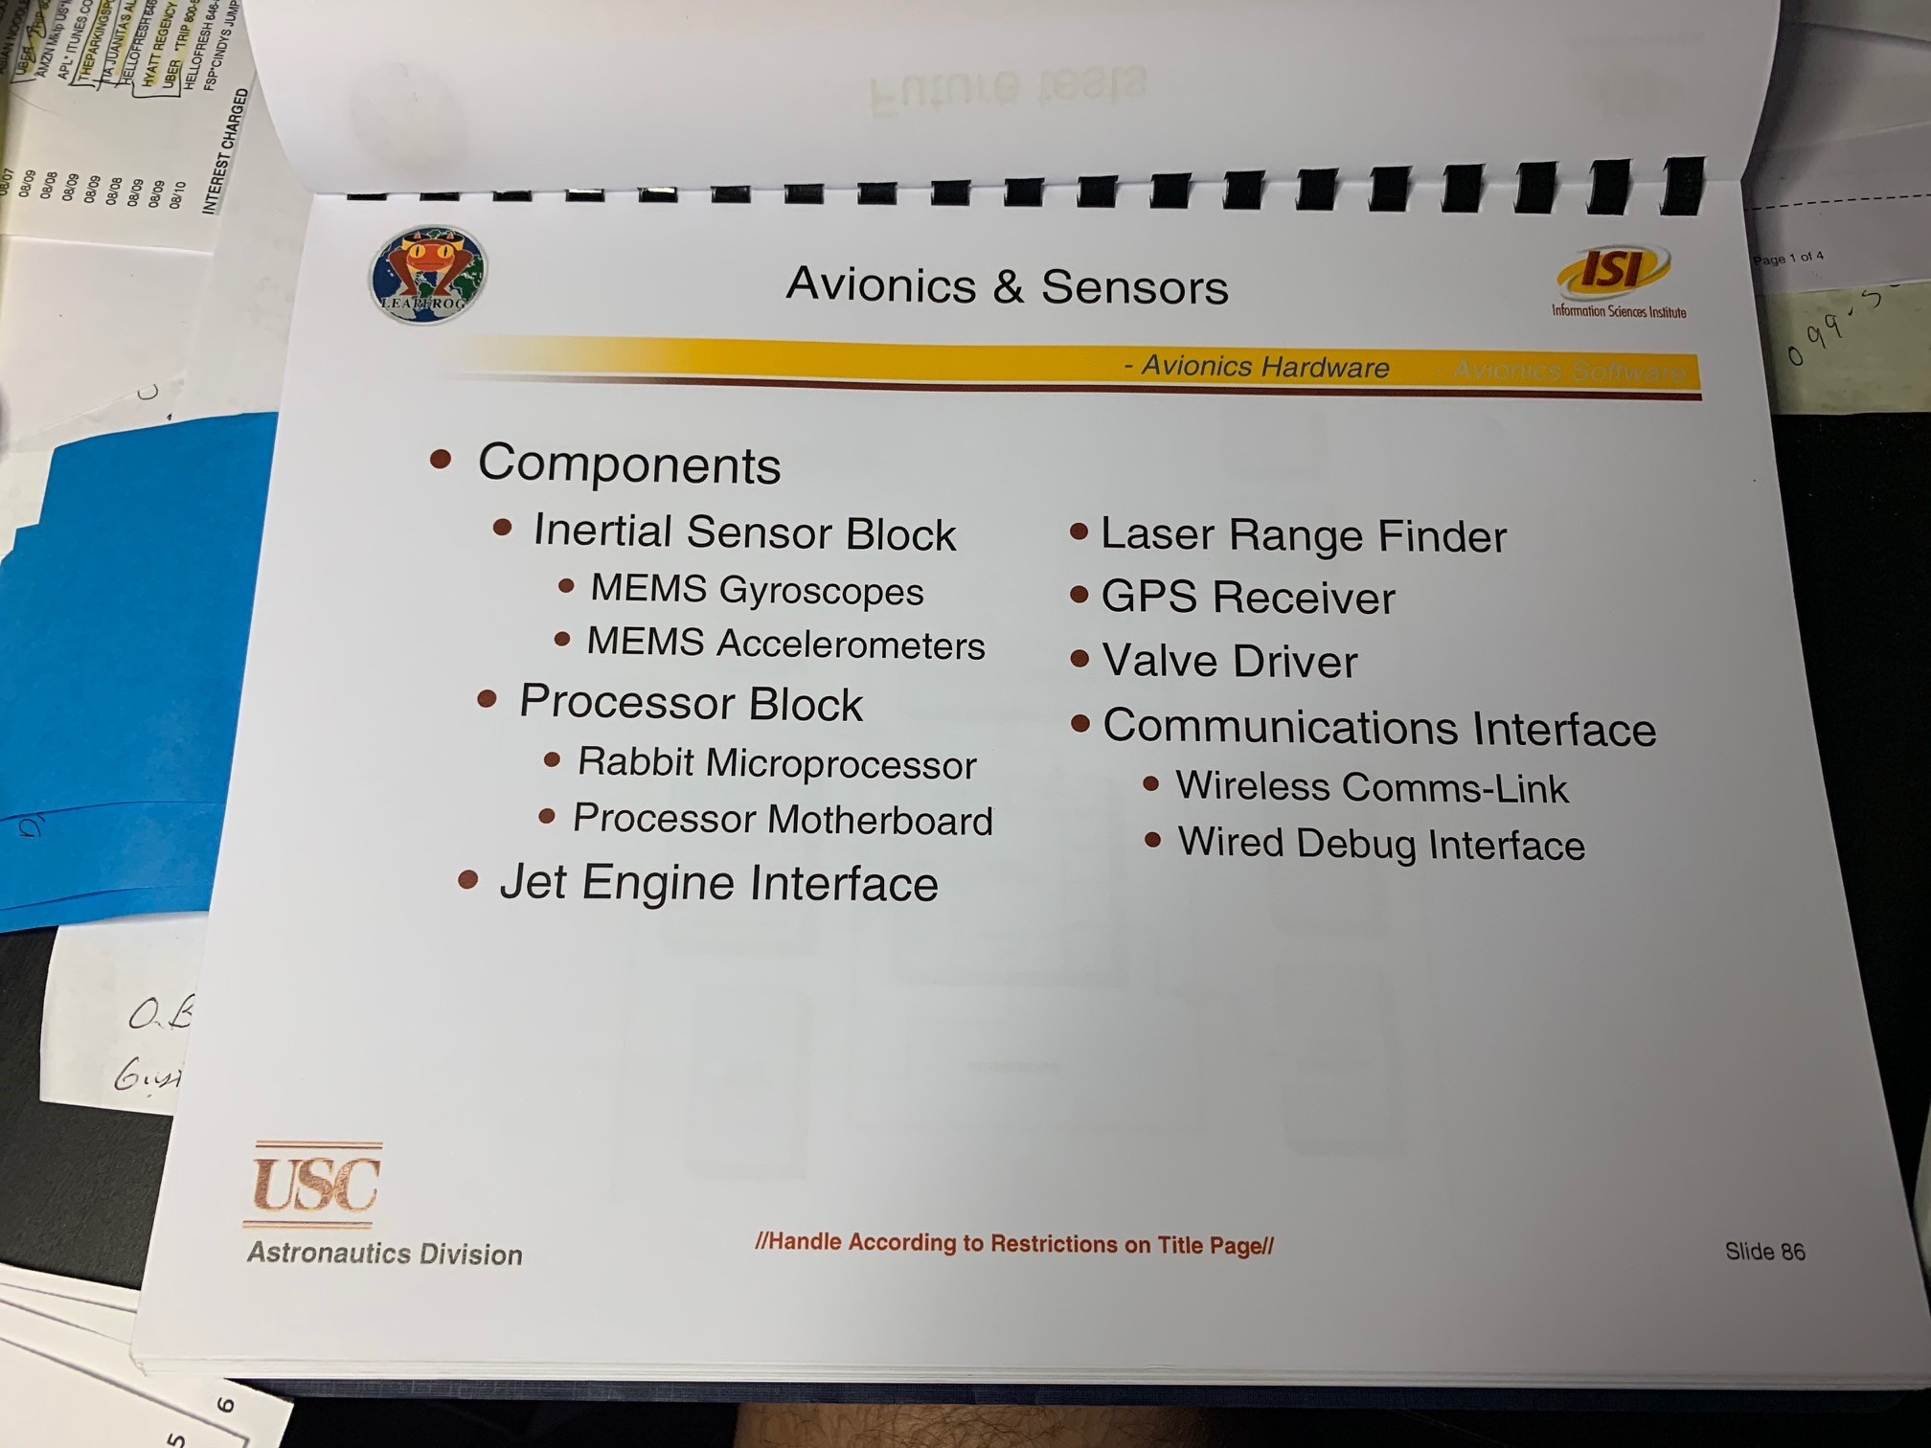
Avionics and Wireless Systems
Identify all the key components

Slide 32
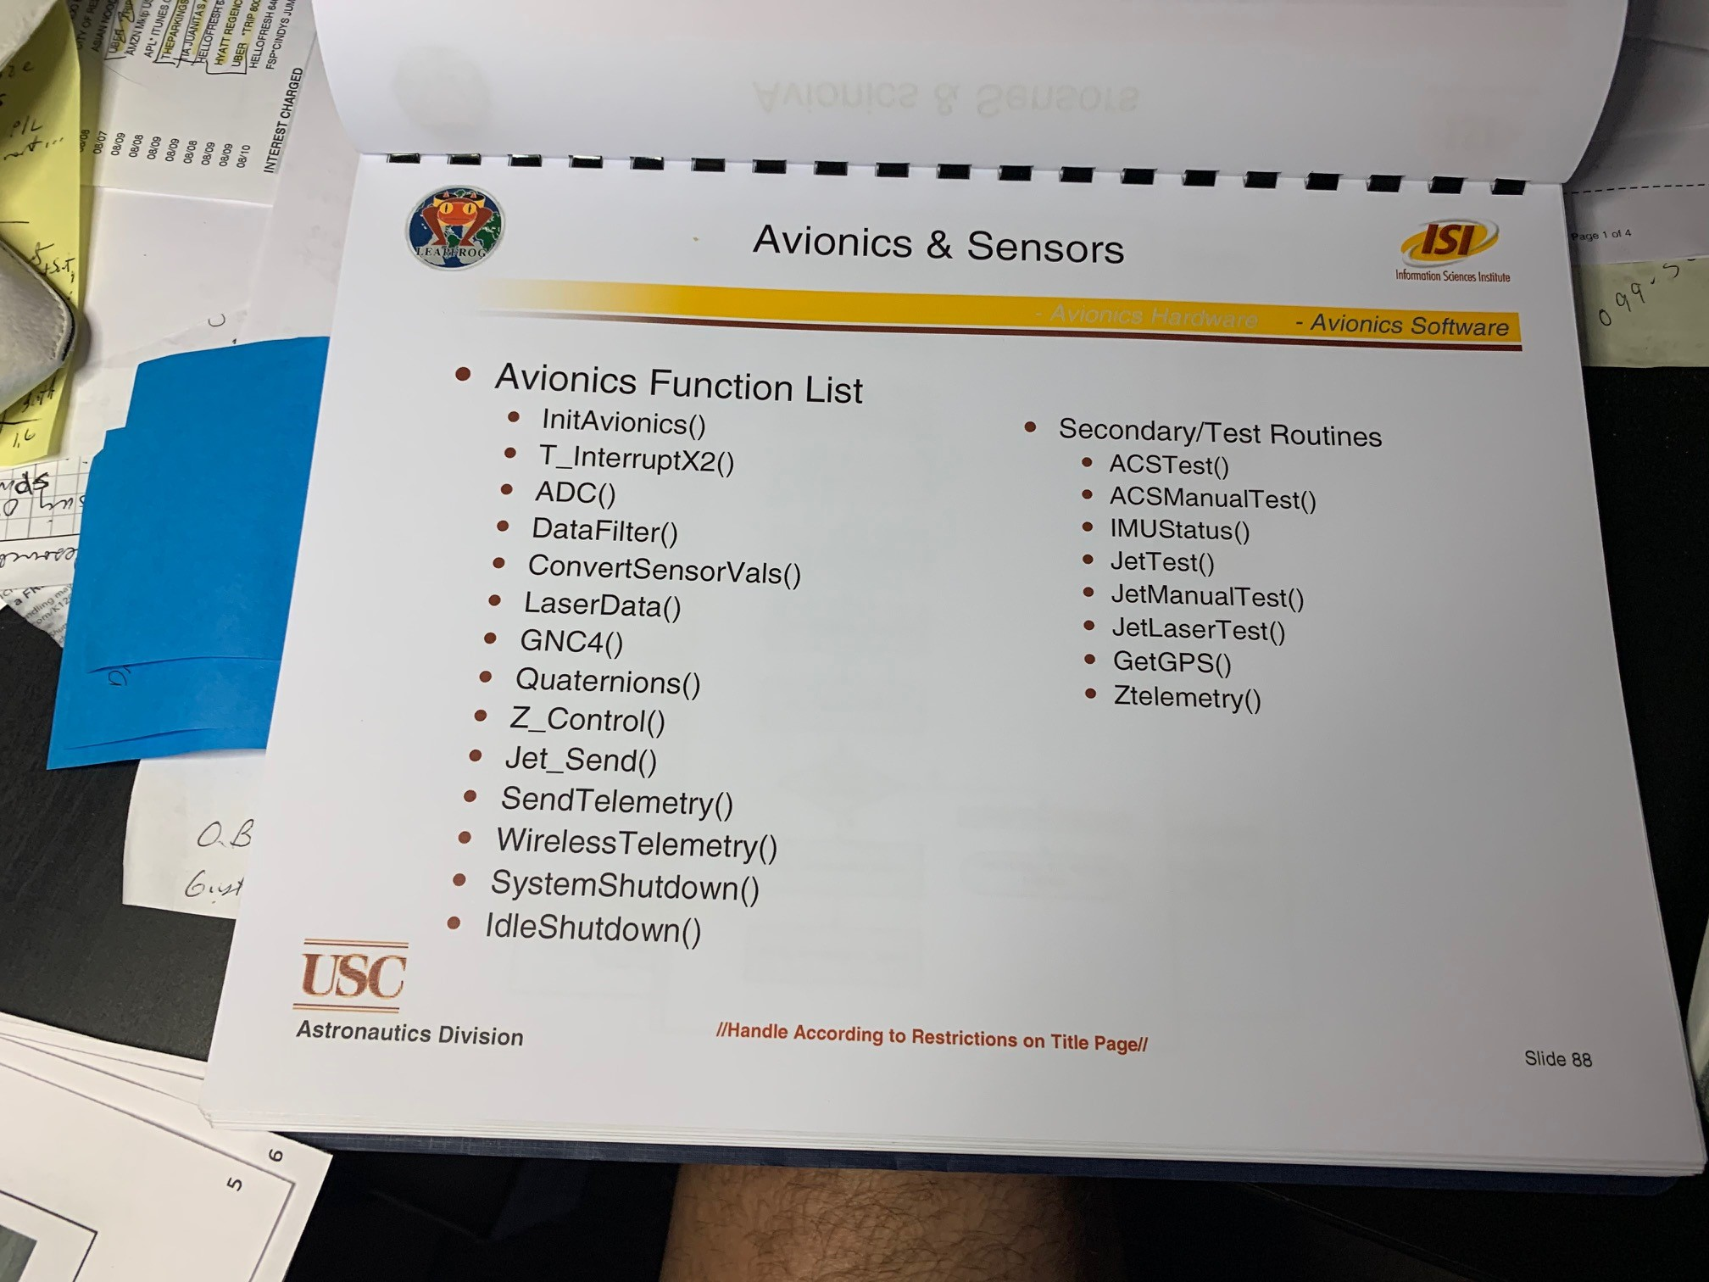
Avionics Primary function list (can be pseudo commands, but list of what you need the avionics to do)

Slide 33
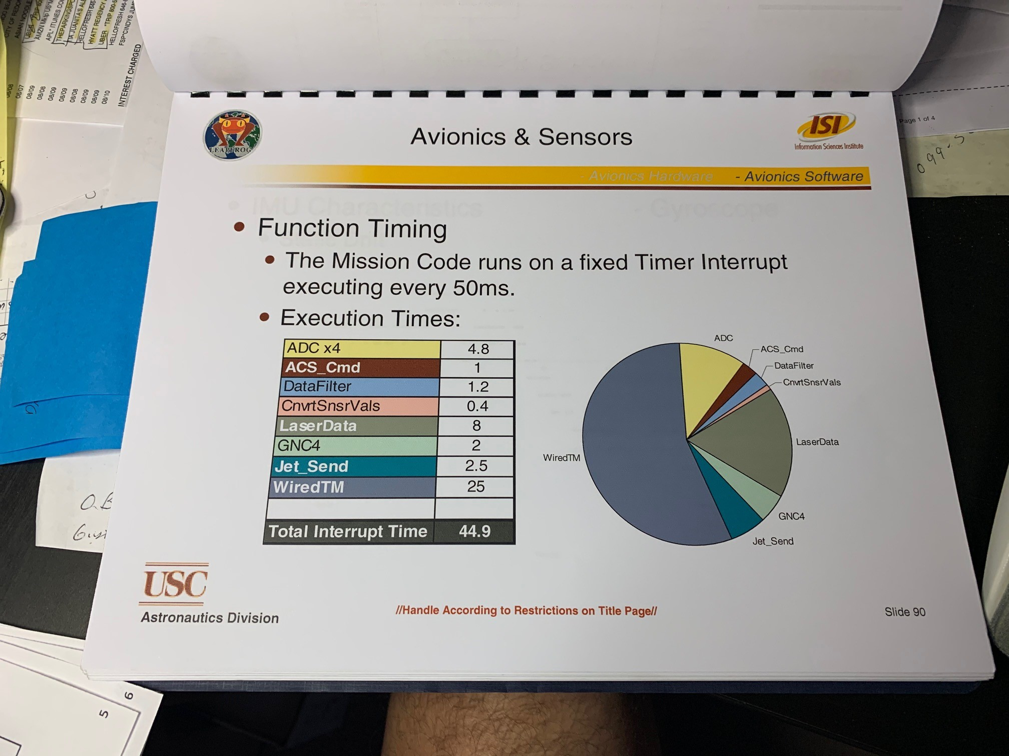
Avionics Timing of functions…

Slide 34
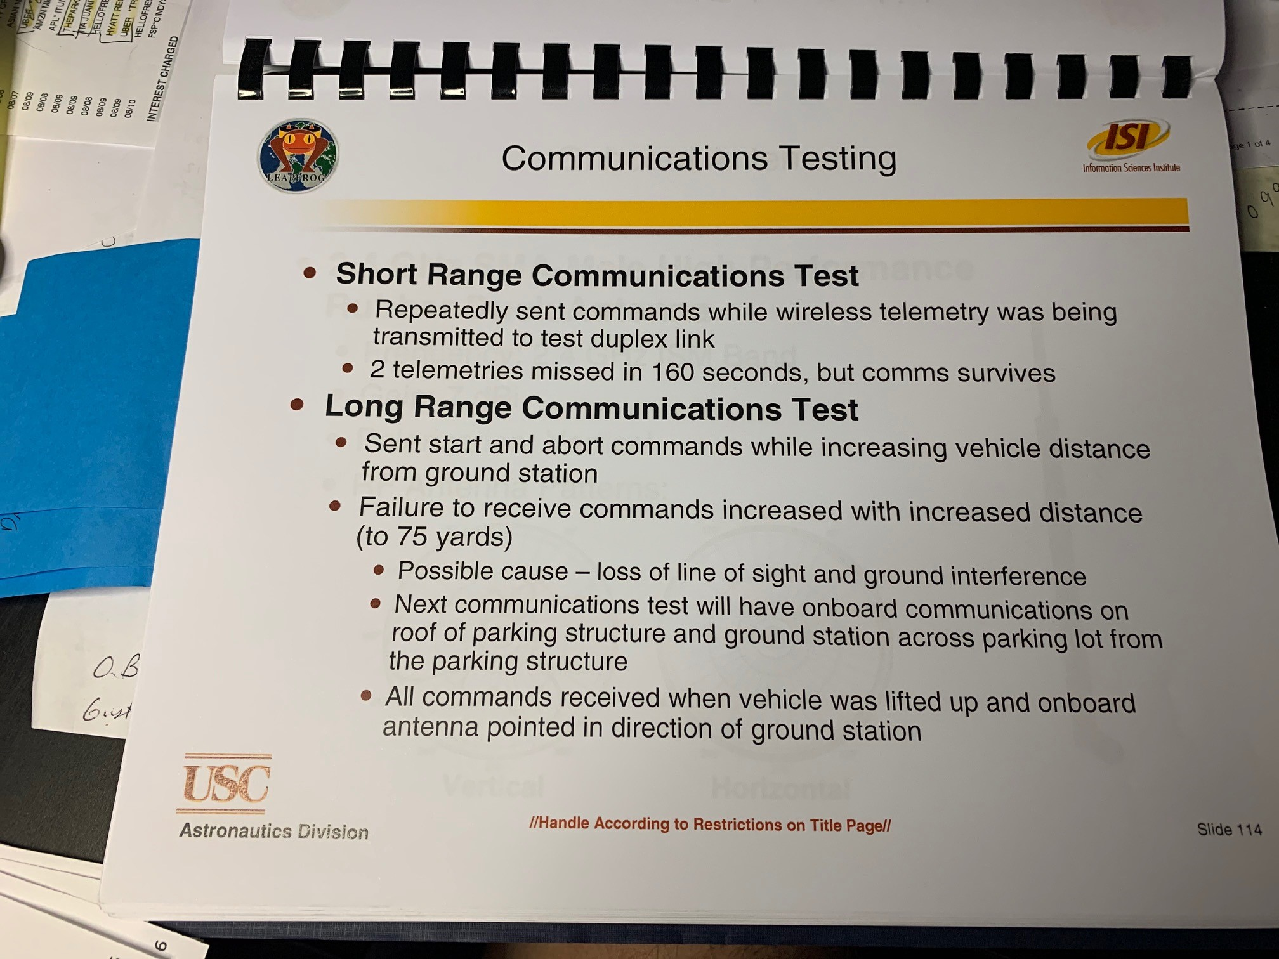
Wireless System Requirements

Slide 35
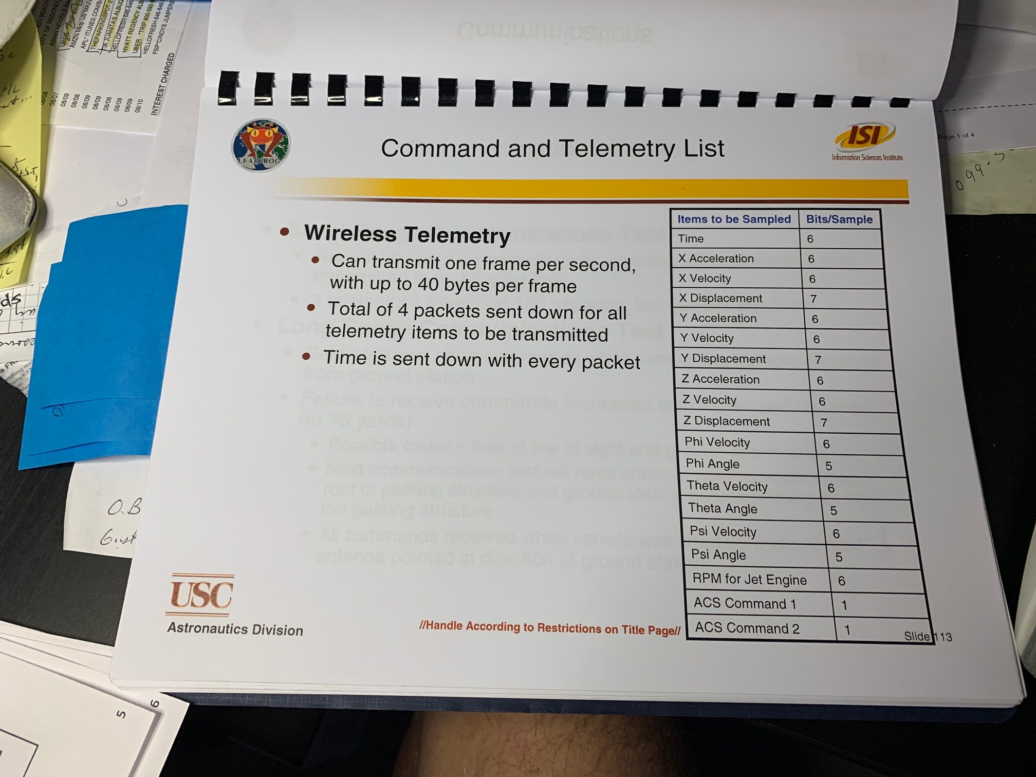
Command and Telemetry List
What does the wireless link have to send up and down to the vehicle

Slide 36
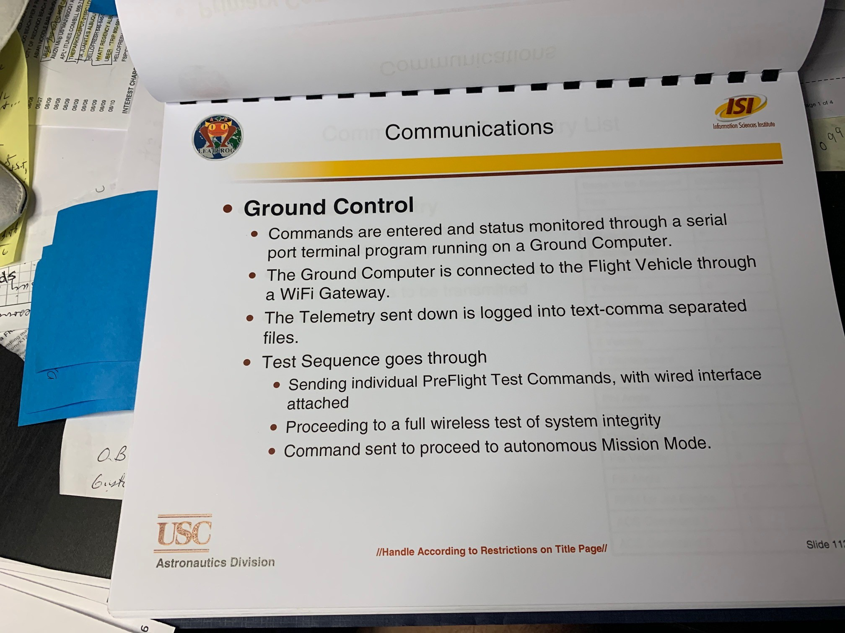
Ground Control for Communications
What does it have to do?

Slide 37
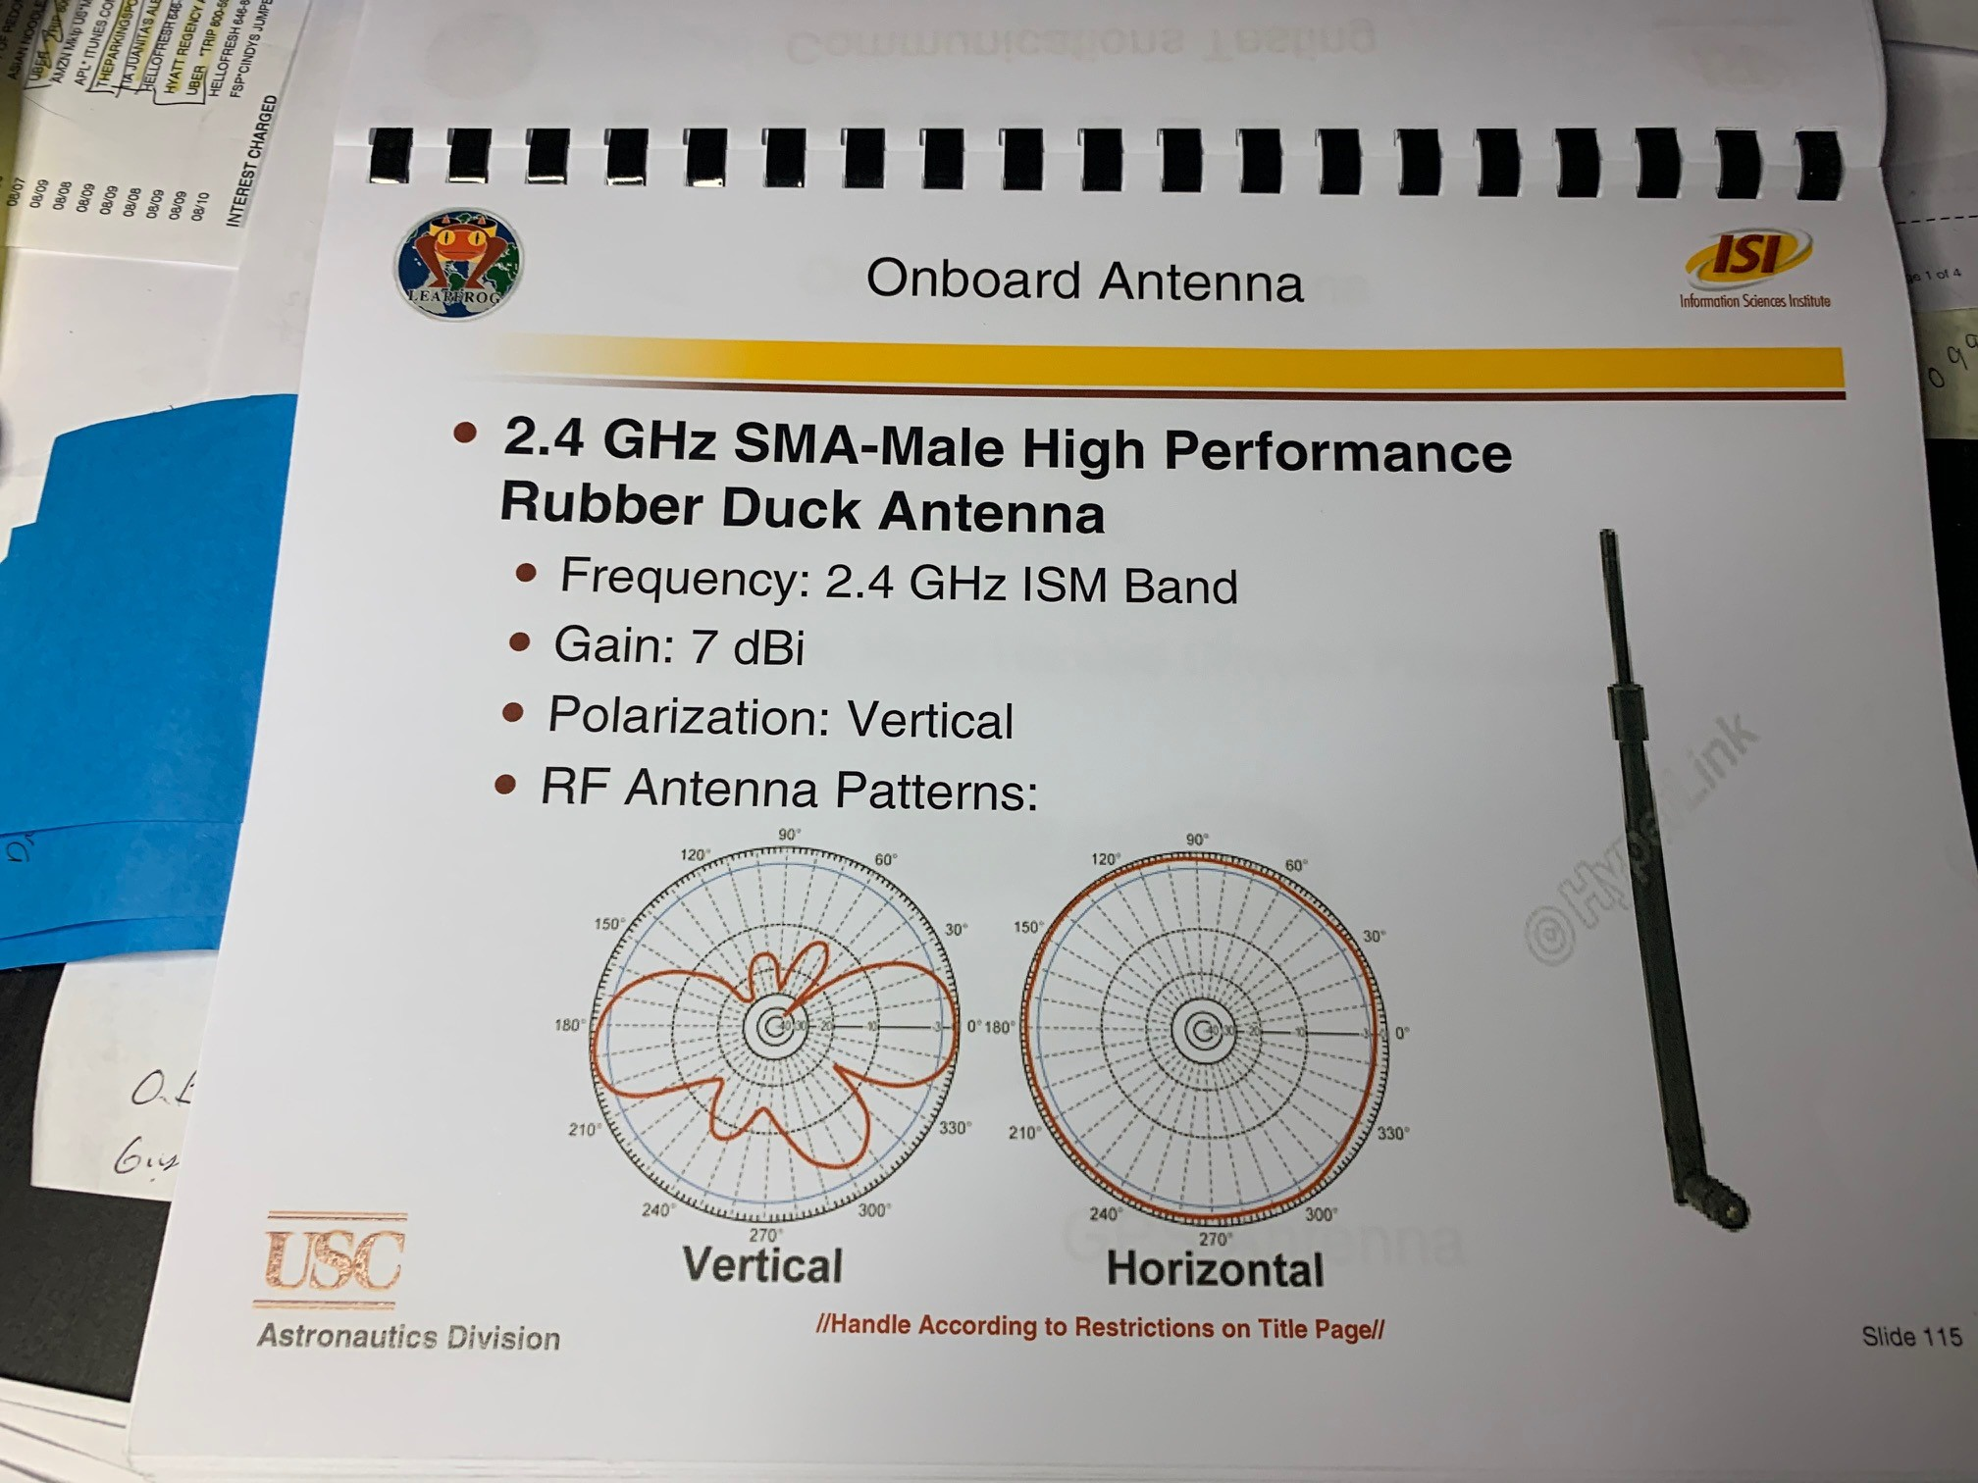
Wireless components
Show transmitter and antenna, validates it will work on larger range

Slide 38
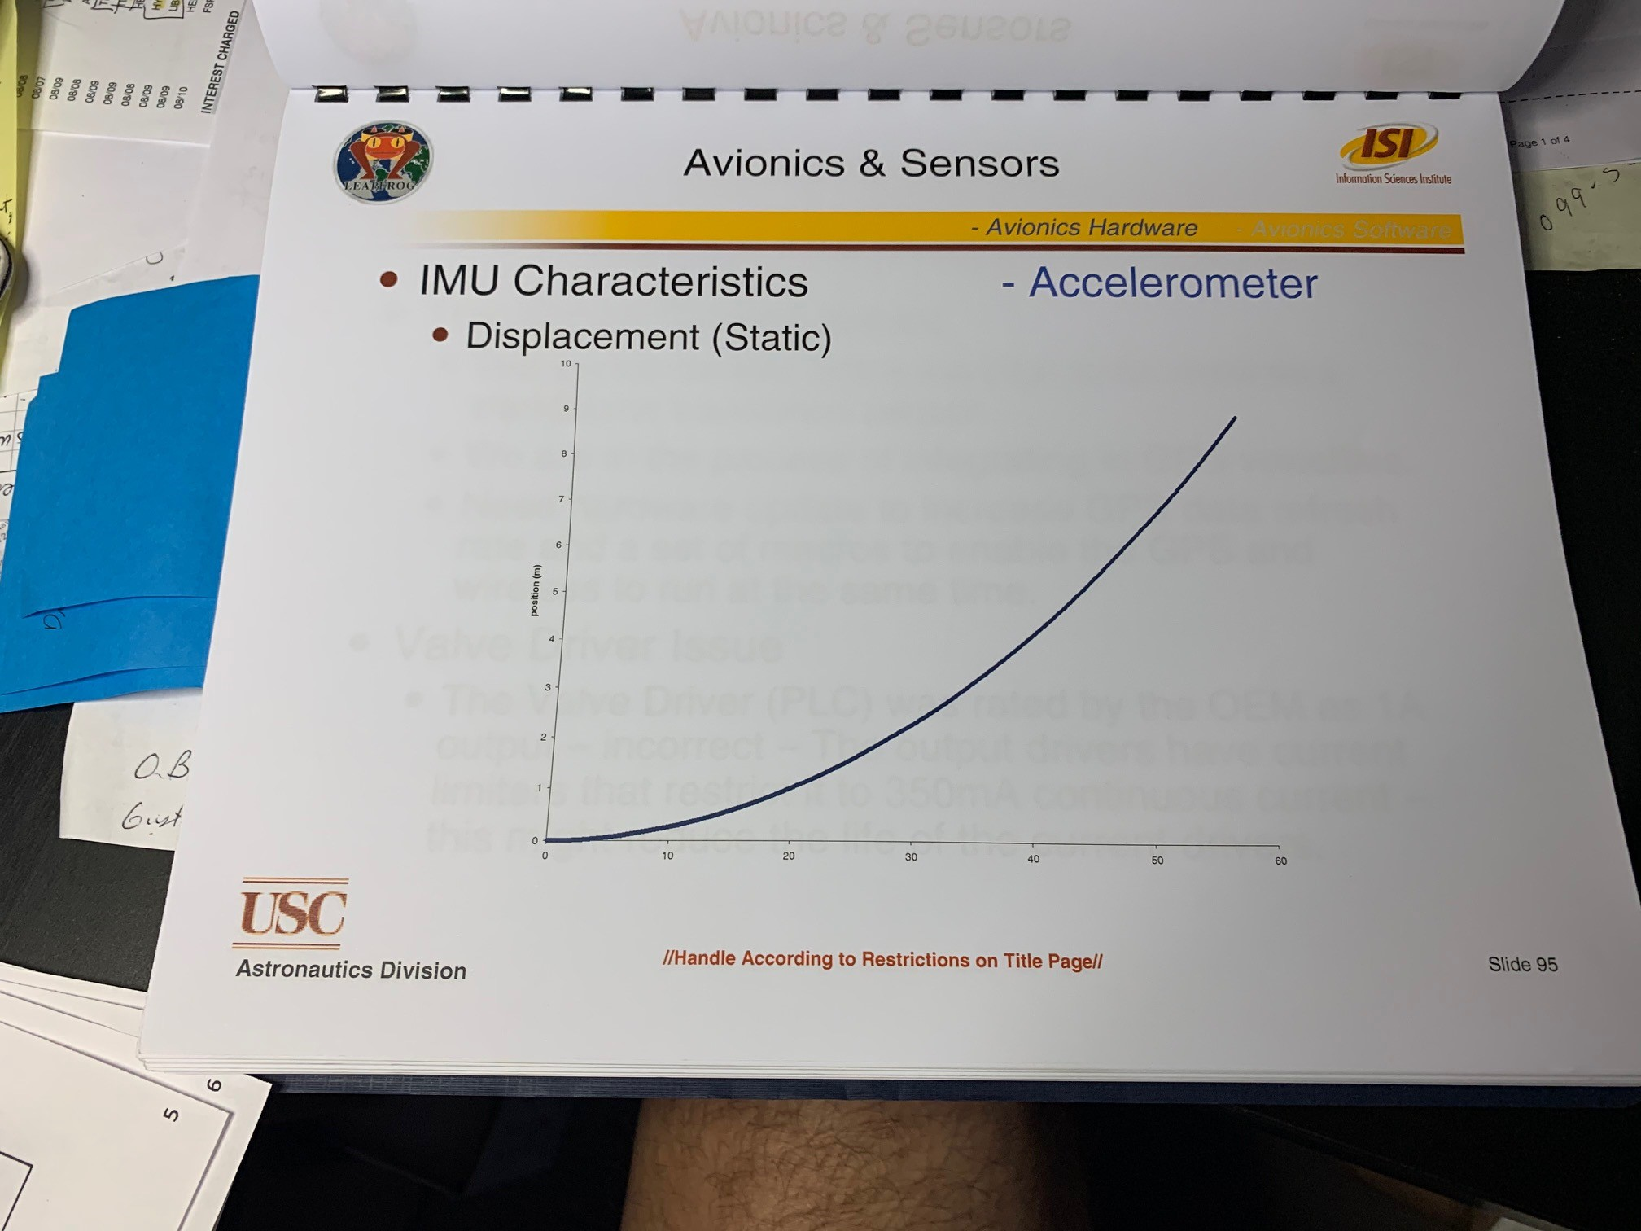
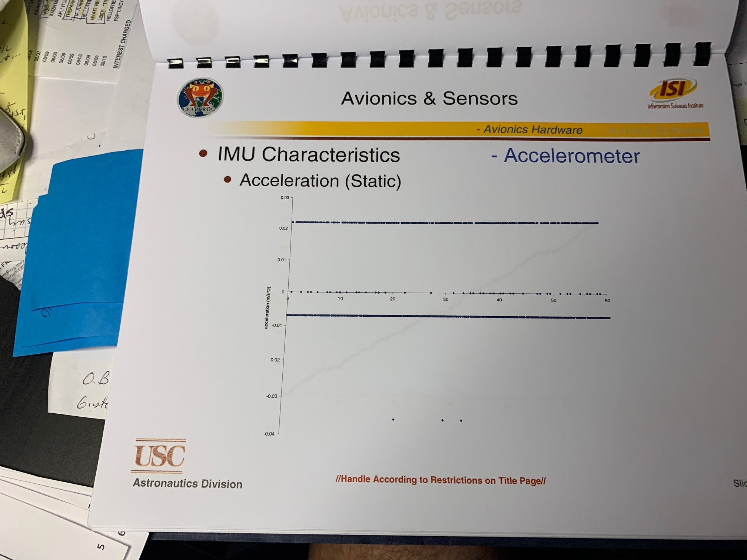
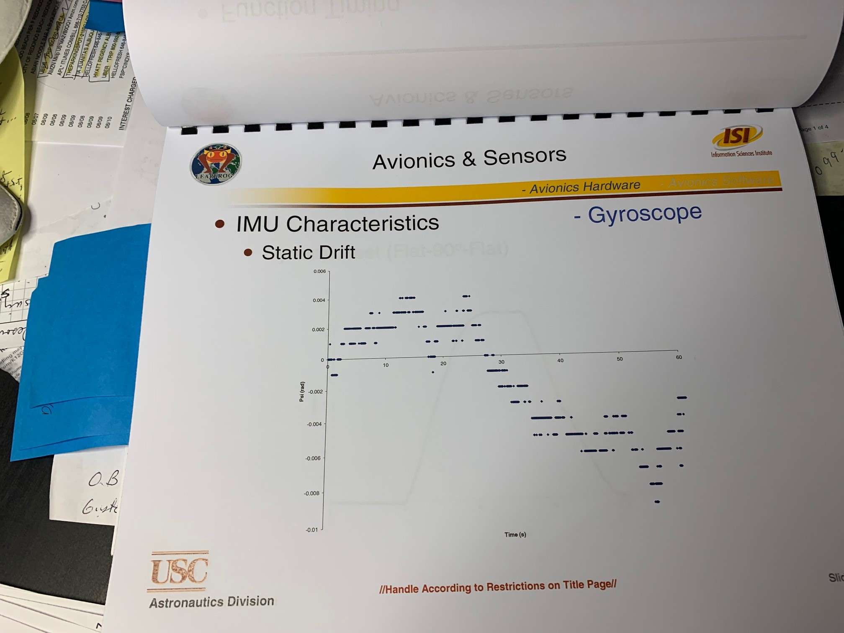
IMU Characteristics
Must show drift, static/dynamic displacement with accel etc

Slide 39
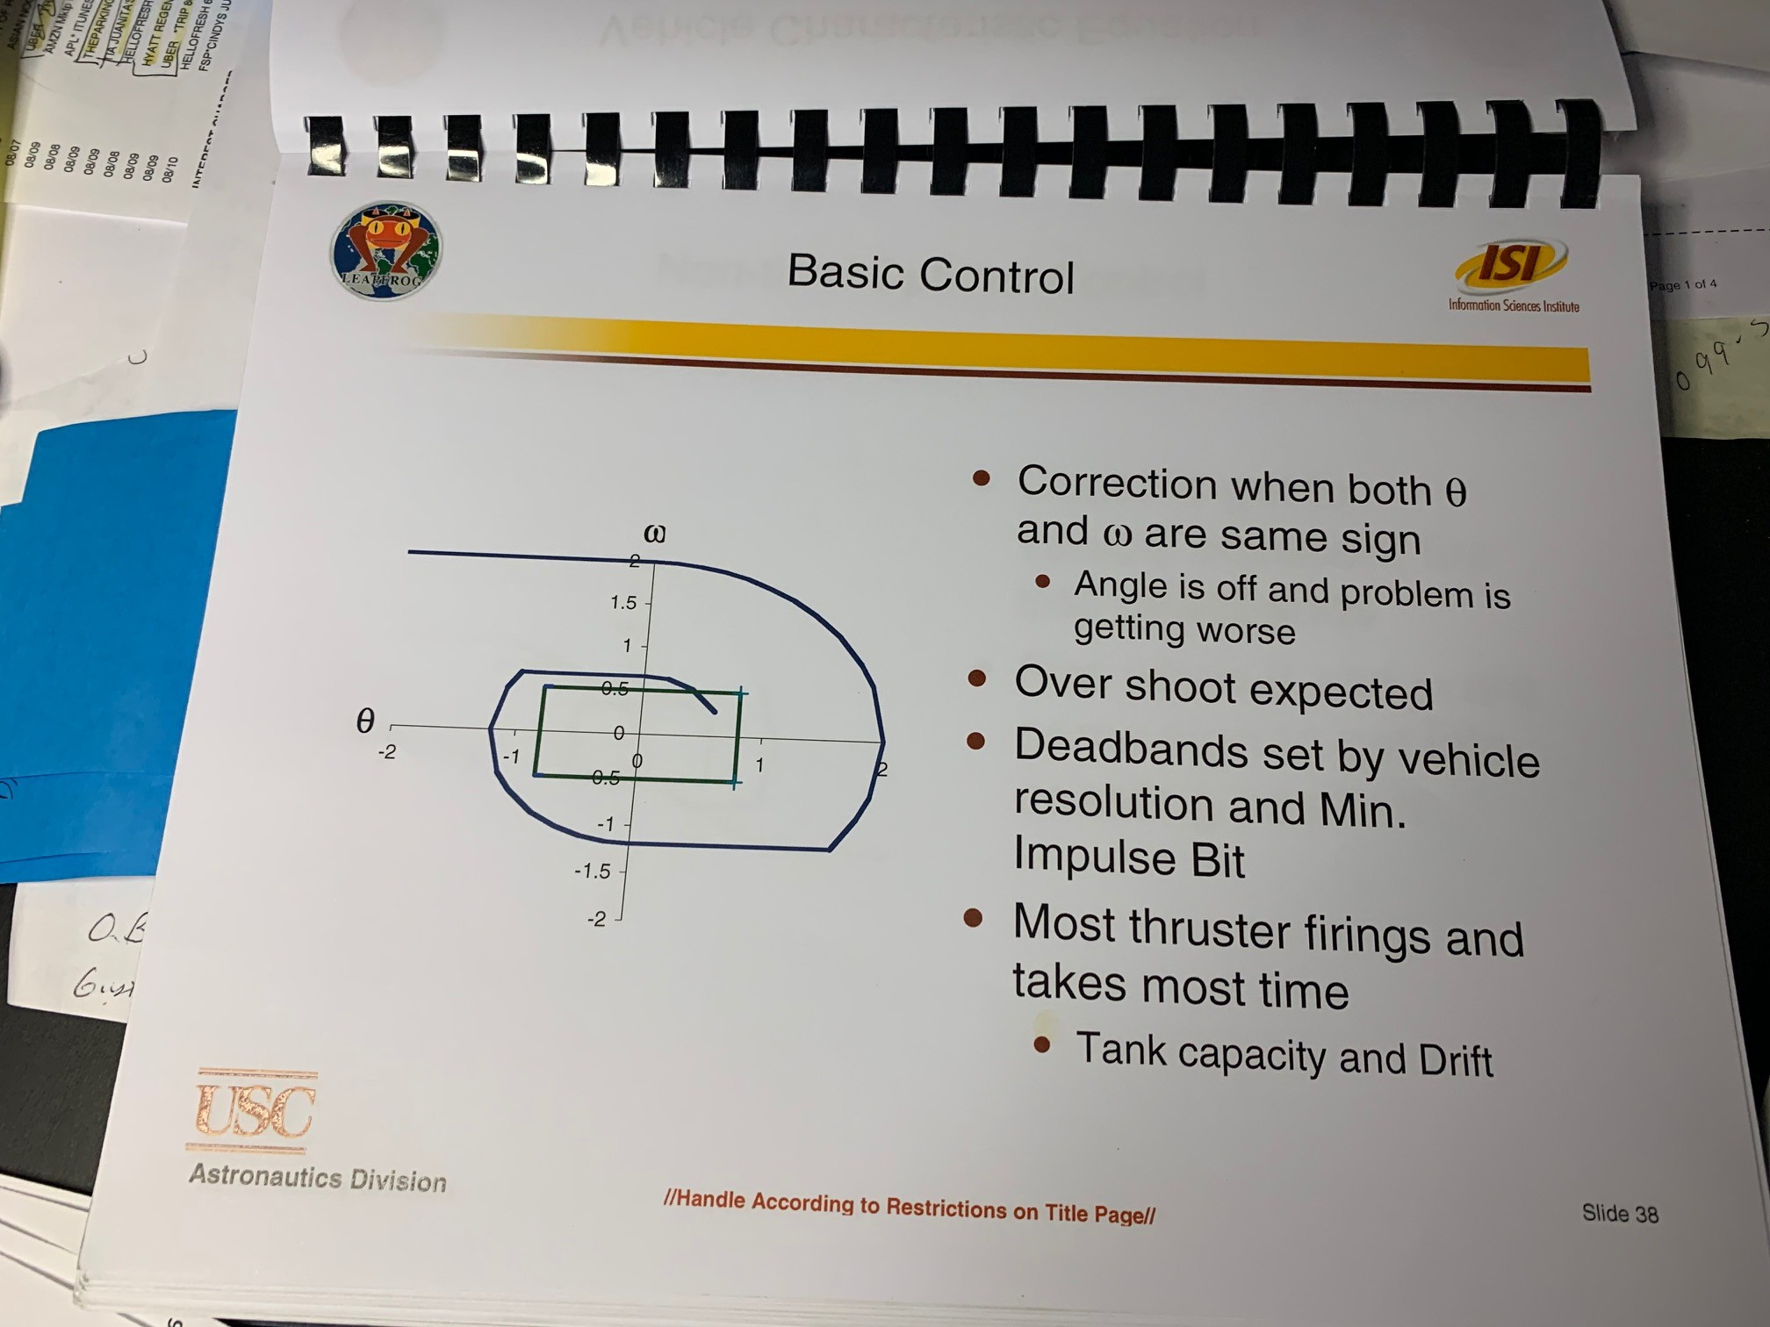
GNC and Engine Control
Here need to show difference between control algorithm for ACS and TVC (example shown)

Slide 40
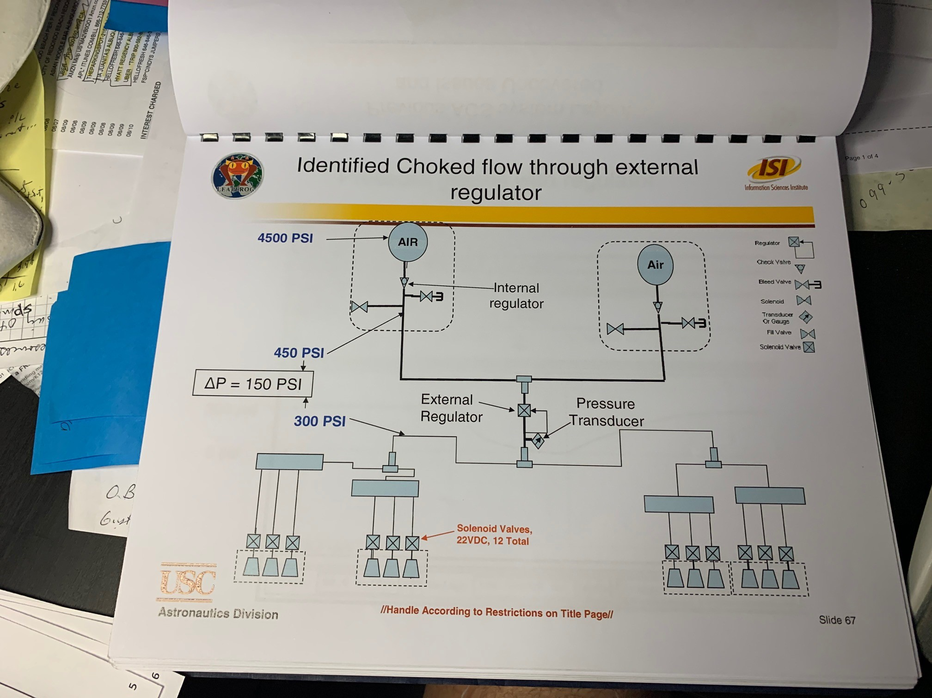
ACS Schematic

Slide 41
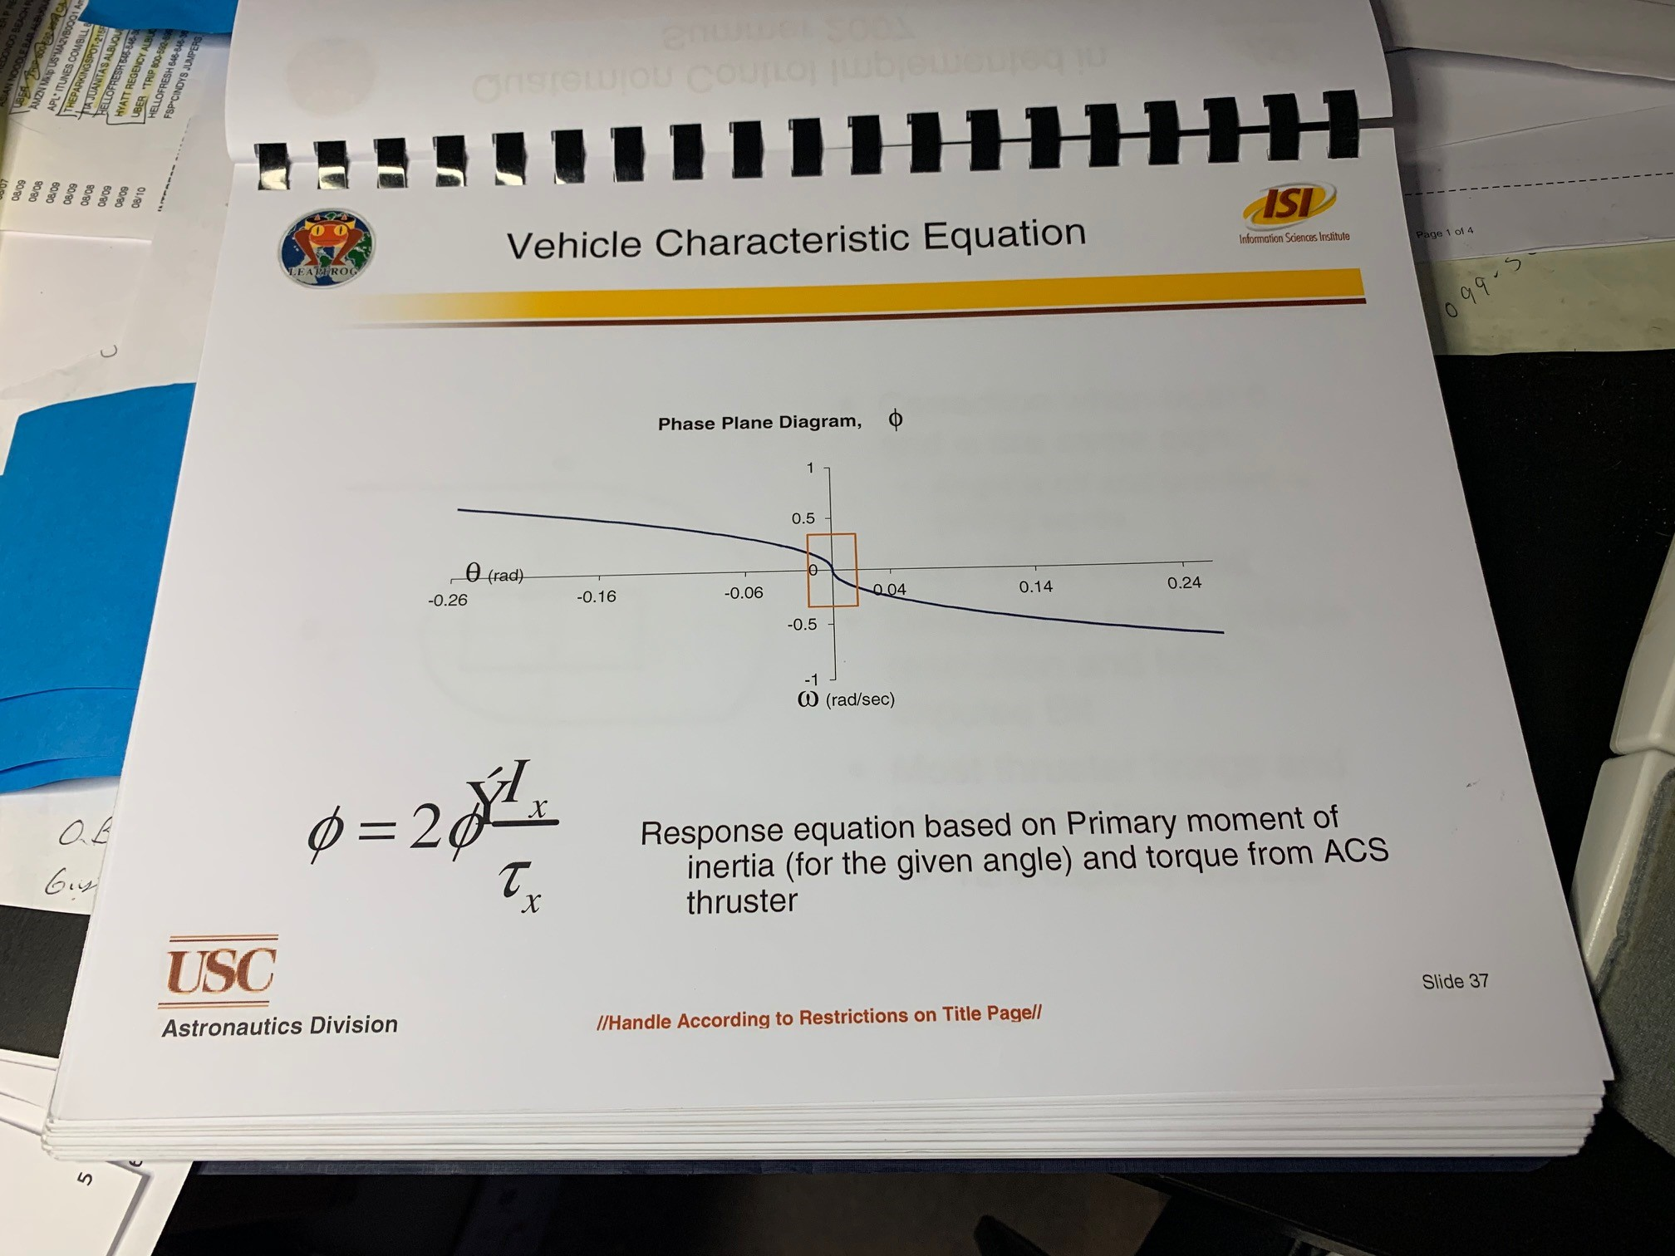
ACS Stability control based on vehicle characteristics
tbd

Slide 42
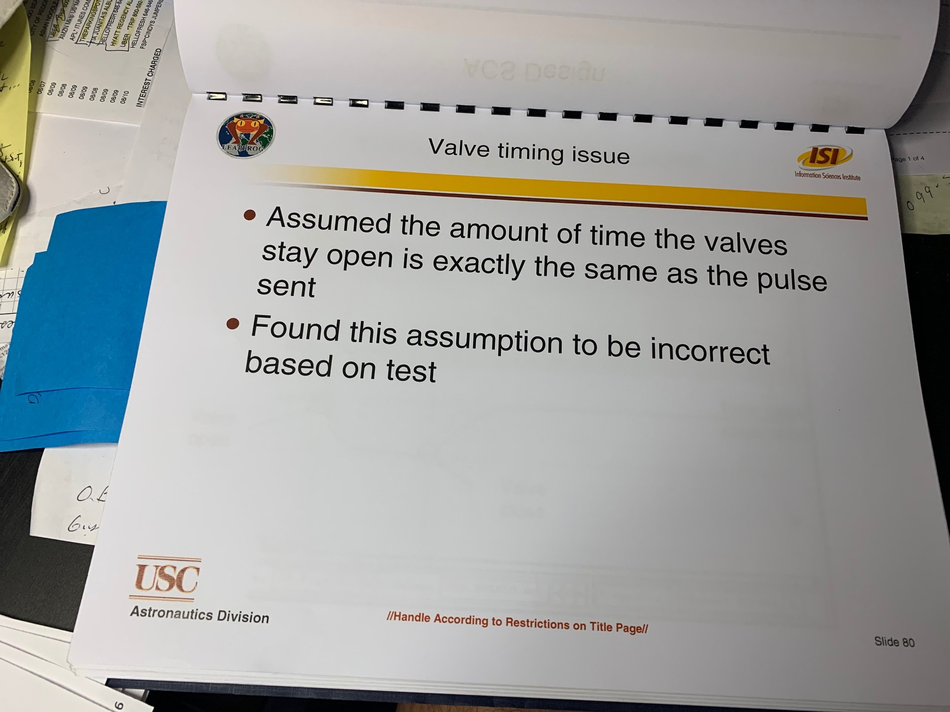
ACS Valve Response
Must validate valve response is fast enough and define it, as that sets up the vehicle characteristic equation in state space to show stability (ie not bang bang)

Slide 43
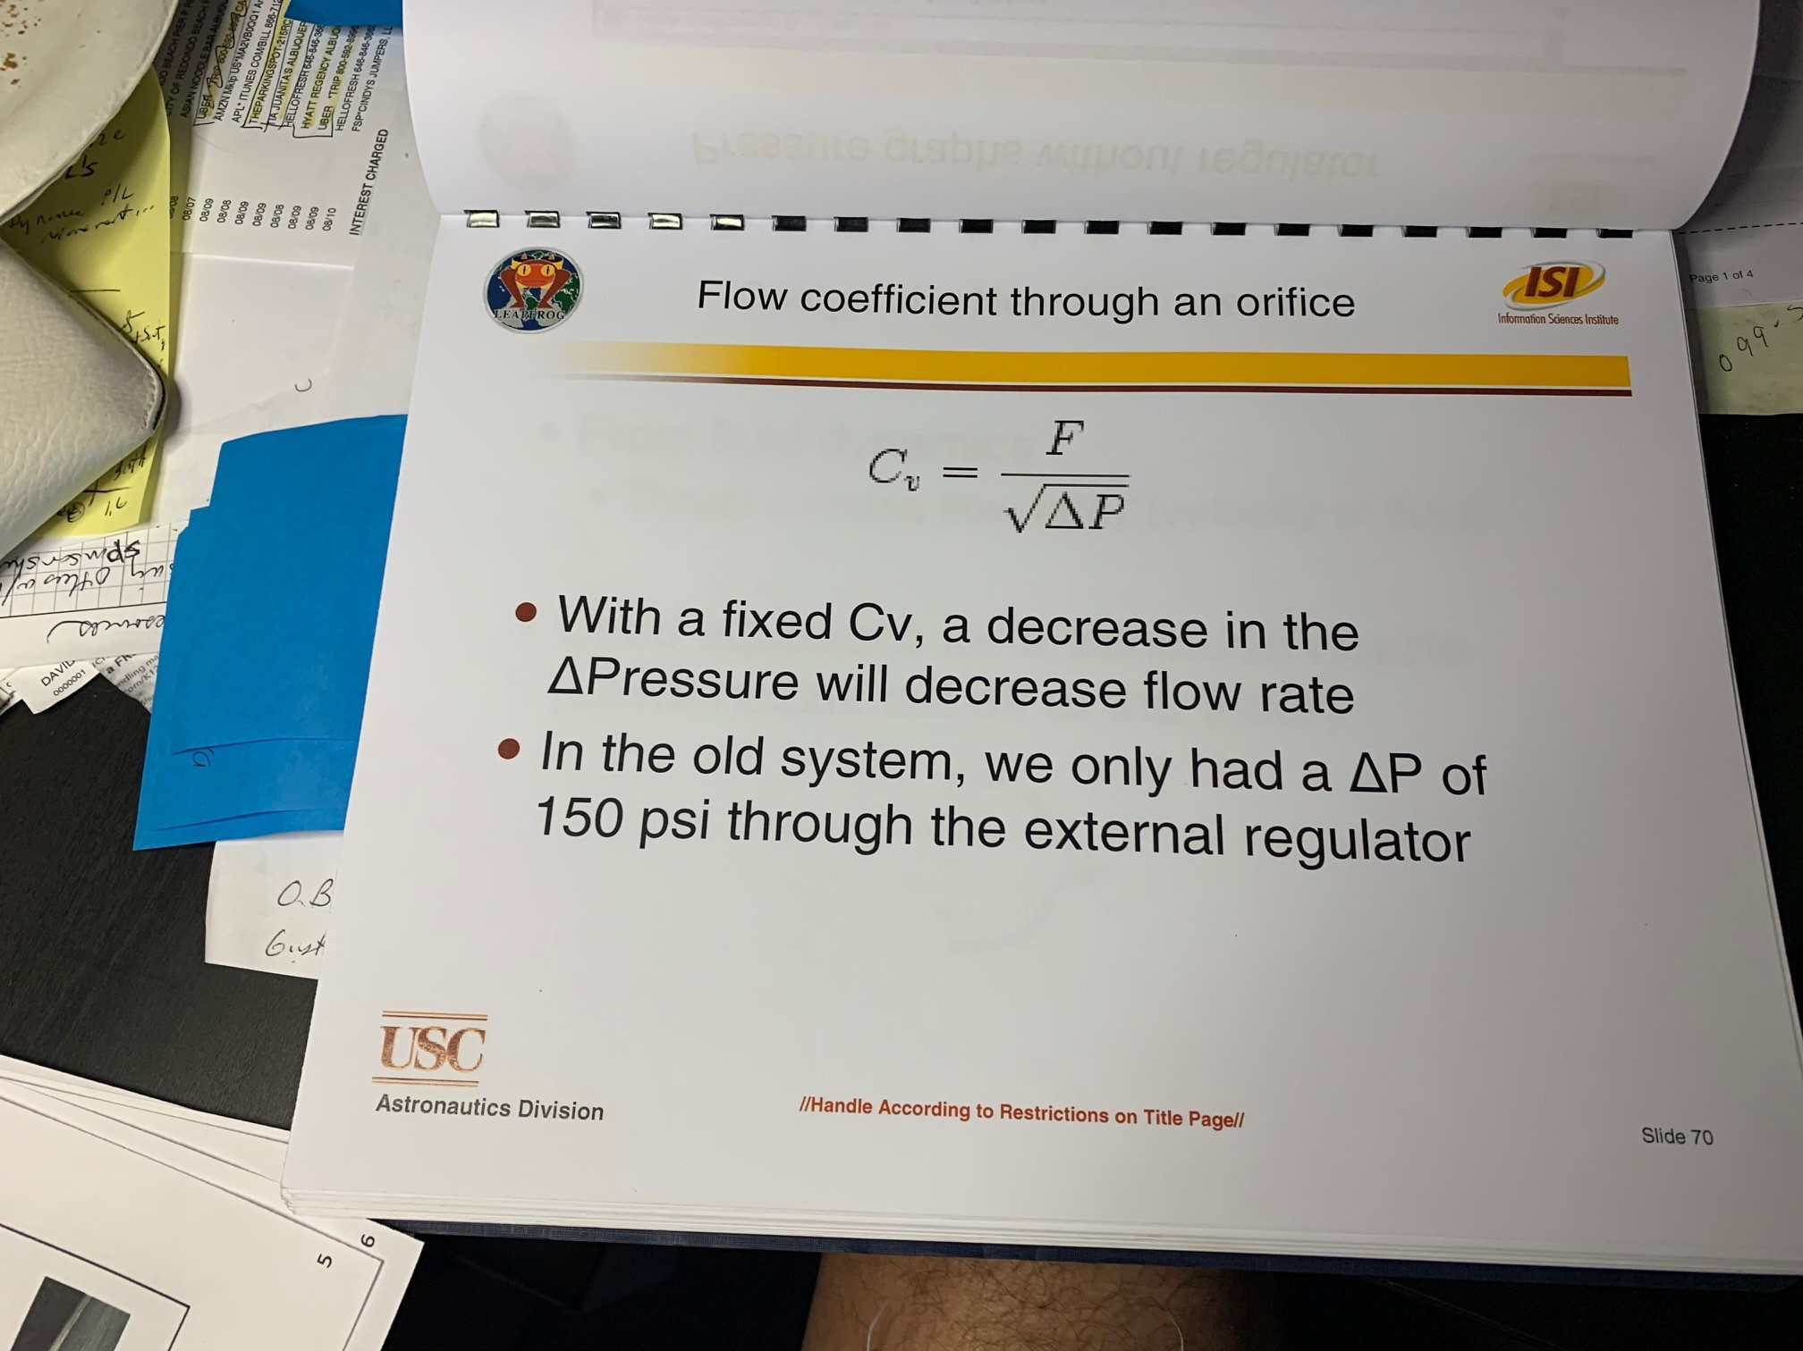
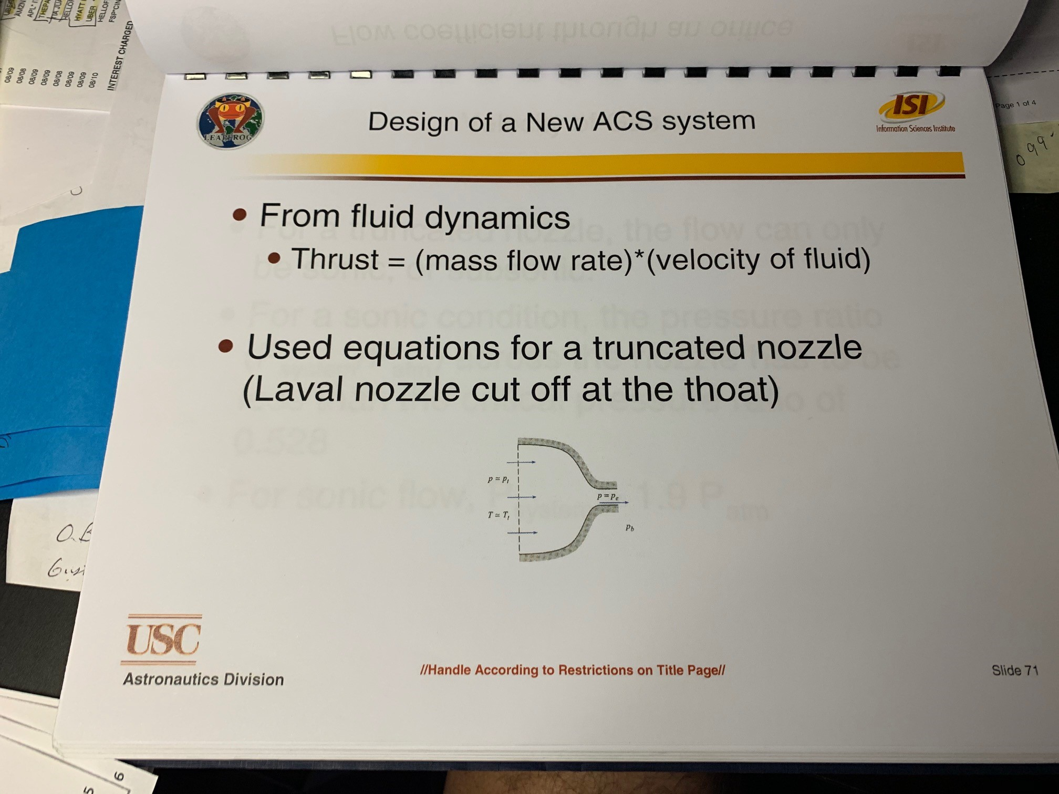
ACS Nozzle Sizing info
tbd

Slide 44
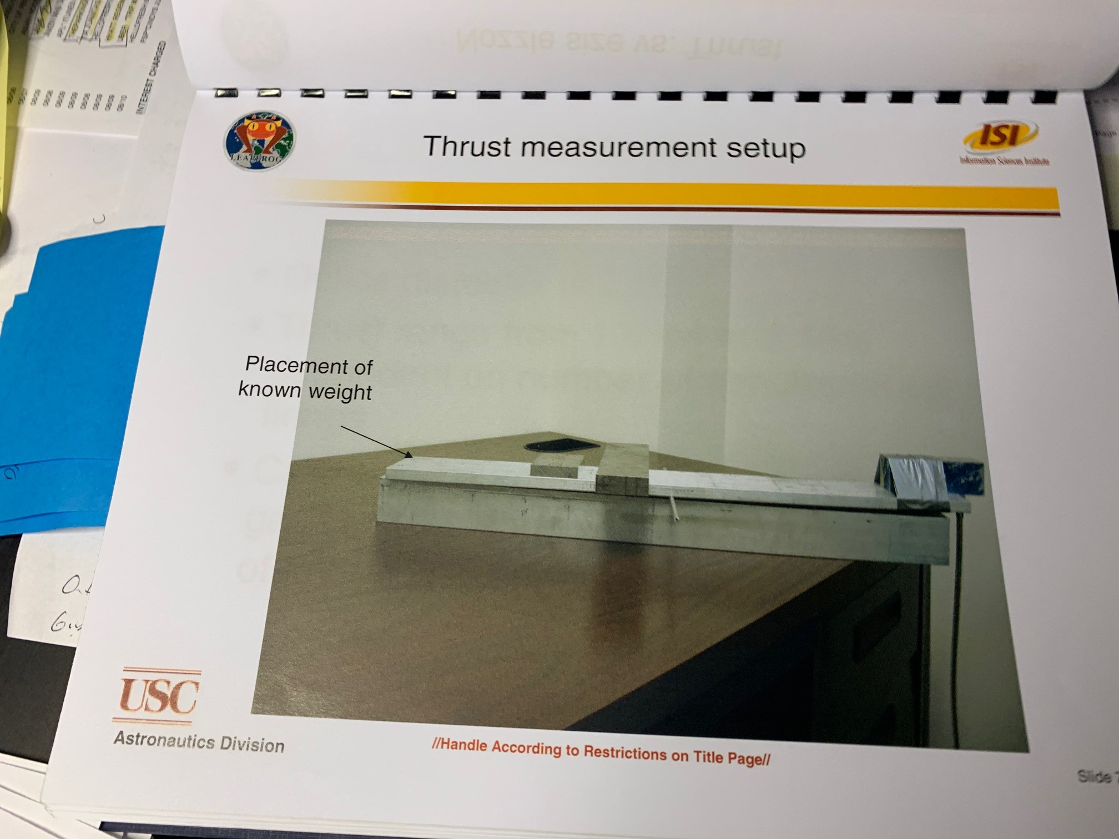
ACS Thrust Measurement setup
This is old one, you have one in the lab, show that, and show results.

Slide 45
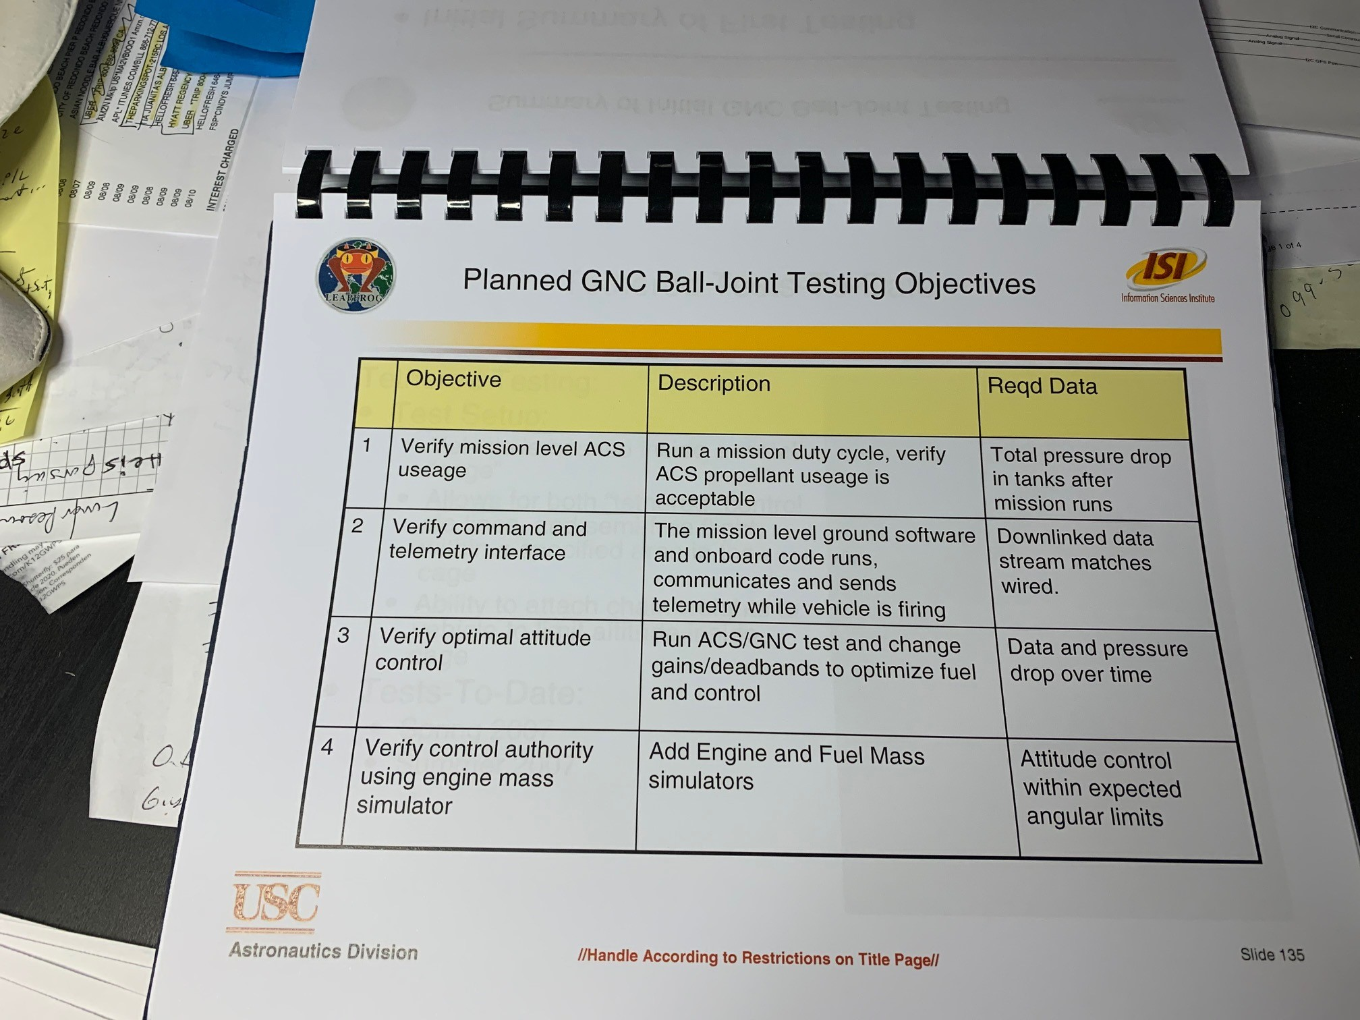
ACS Air Bearing Test Objectives to validate its function
tbd

Slide 46
TVC Schematic
Show simple diagram of how the Engine and actuators etc. Same as ACS layout, but focused on gimbal system to engine

Slide 47
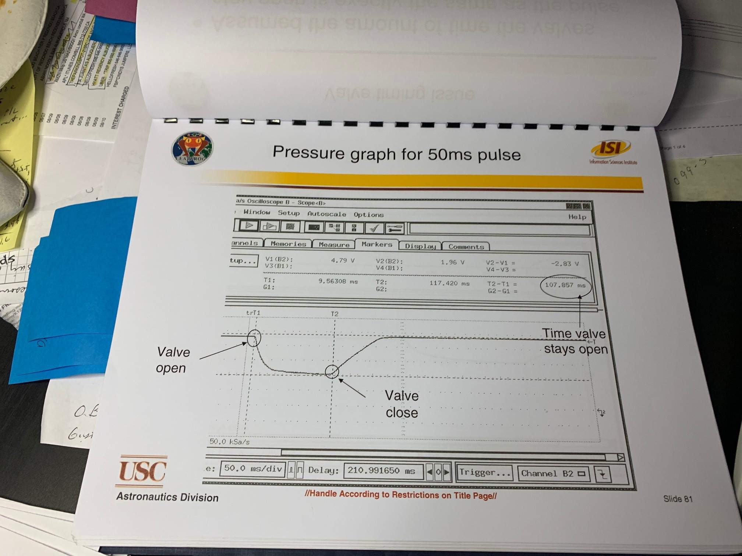
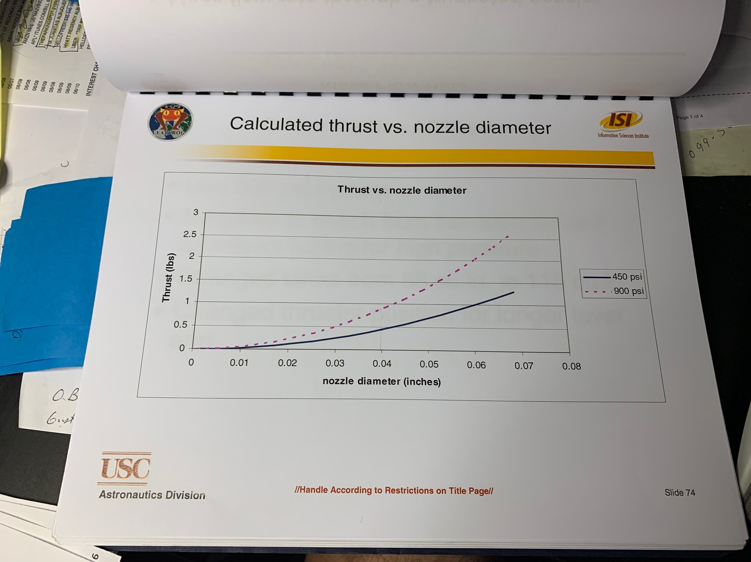
Describe engine Characteristics
tbd

Slide 48
Describe gimbal system characteristics, response from actuators etc etc.
tbd

Slide 49
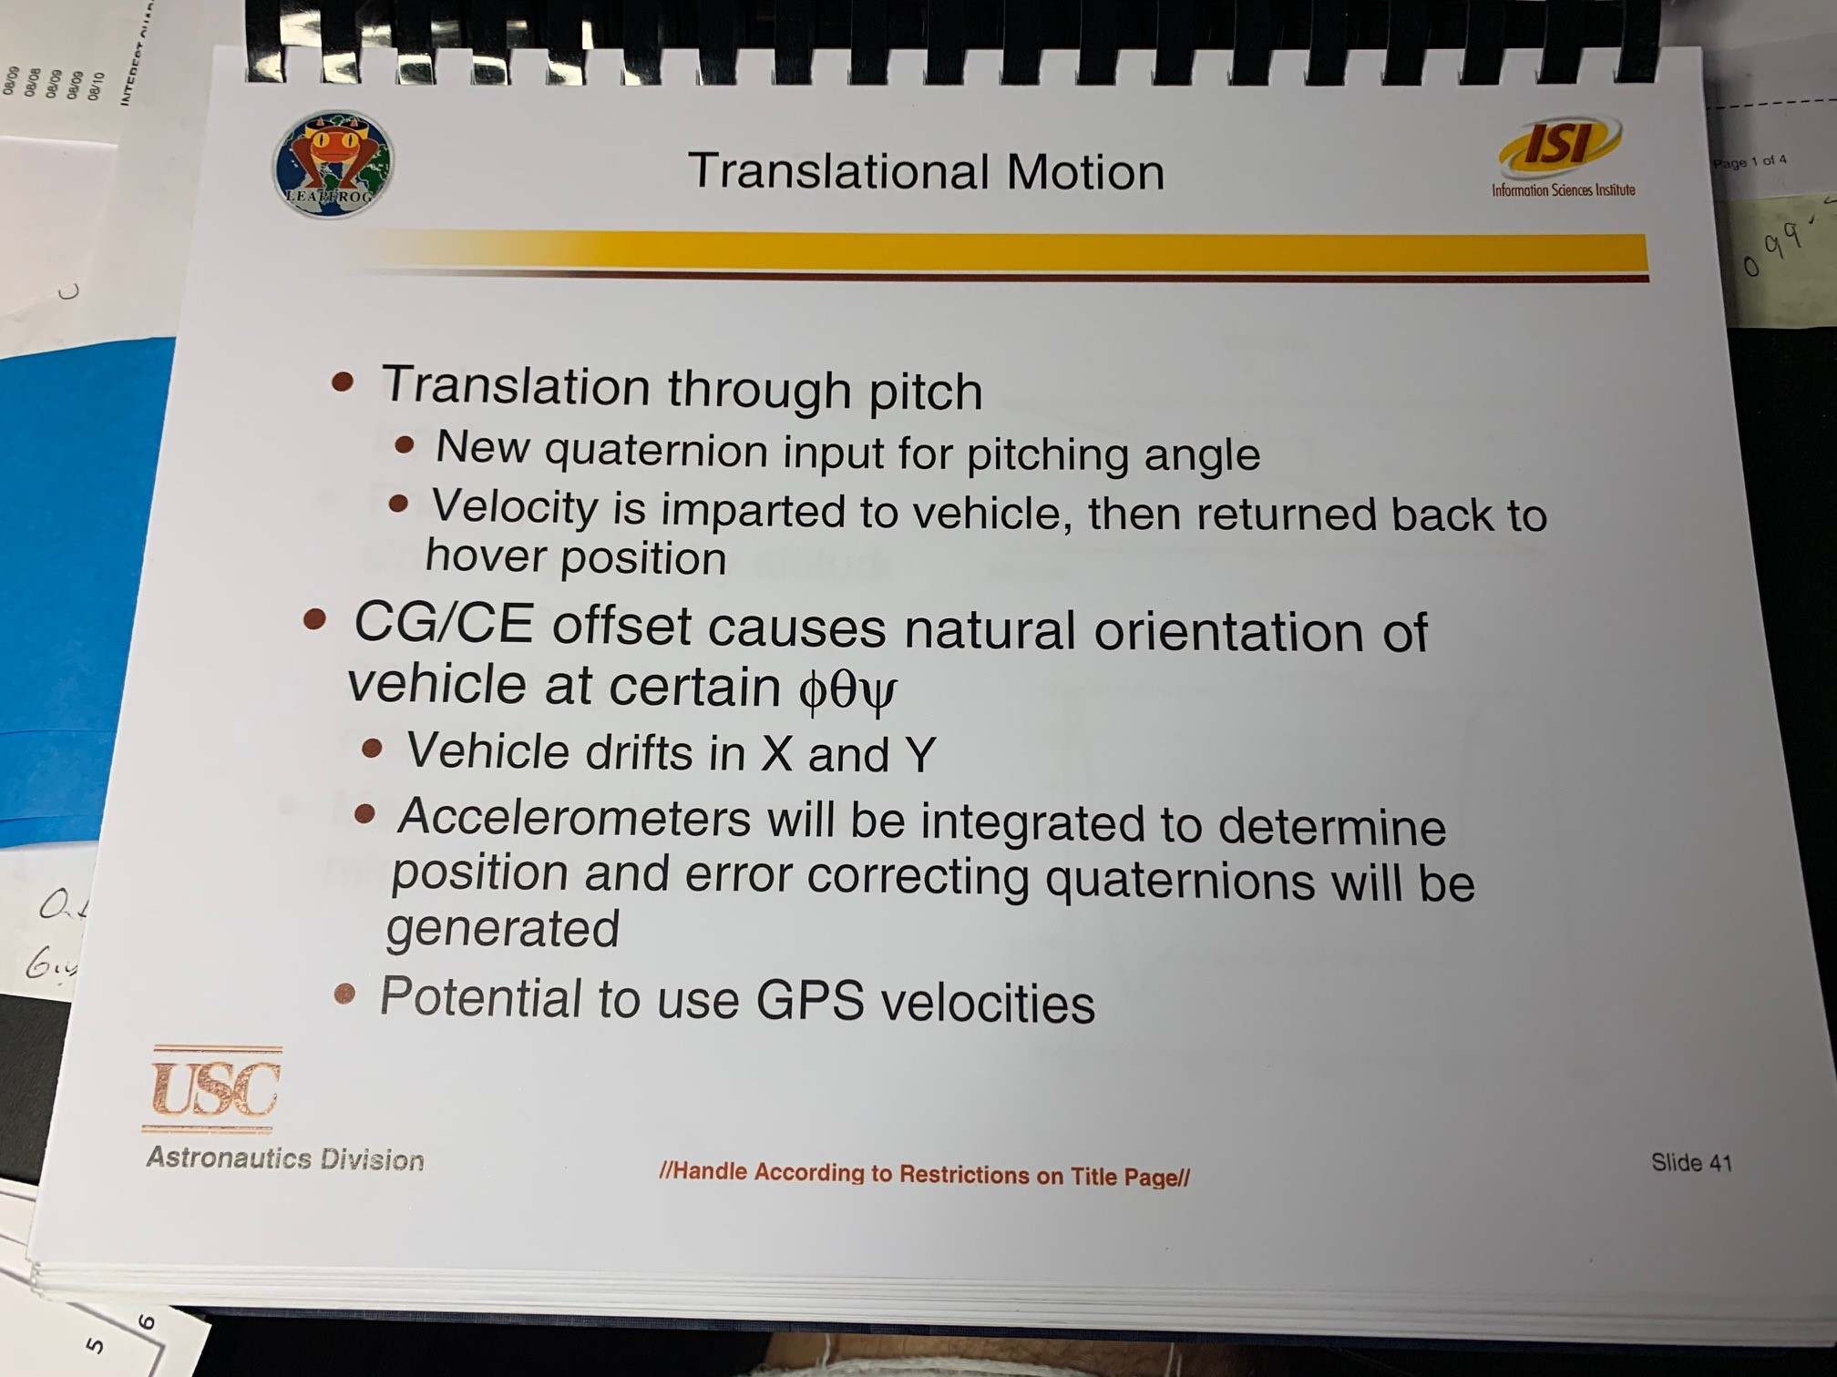
TVC Translation Motion Plans
This was old LEAP, show yours using TVC etc

Slide 50
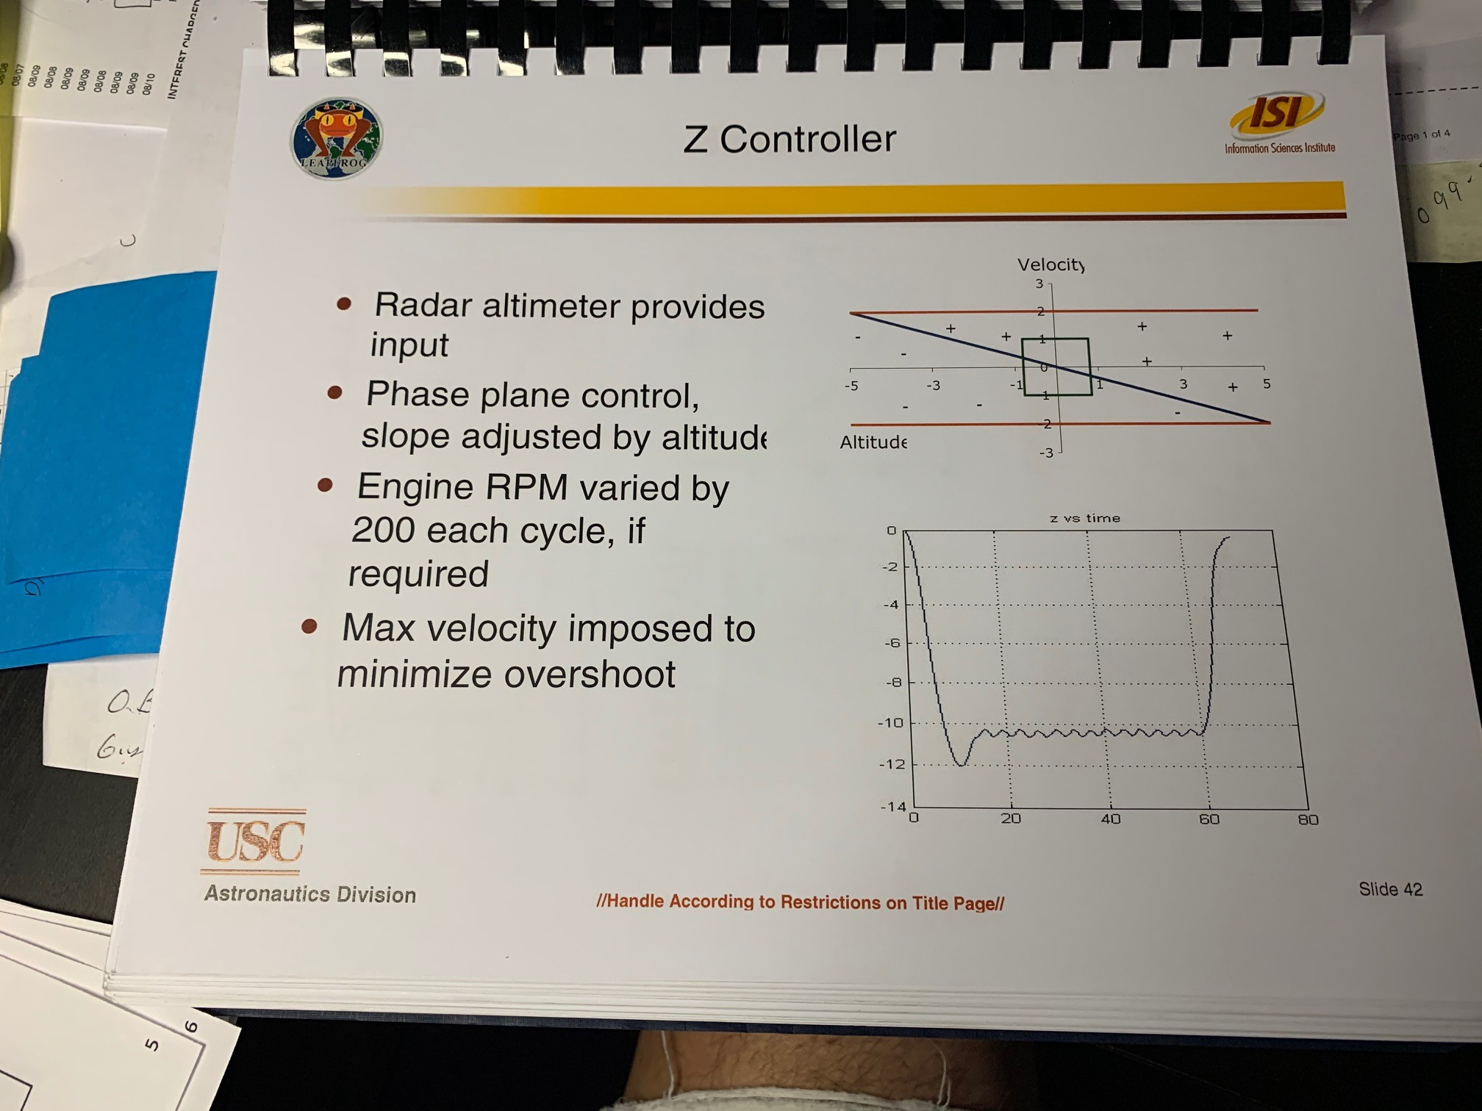
TVC Control and Navigation
Show lateral displacement motion plan
Show altitude control plan
Etc.

Slide 51
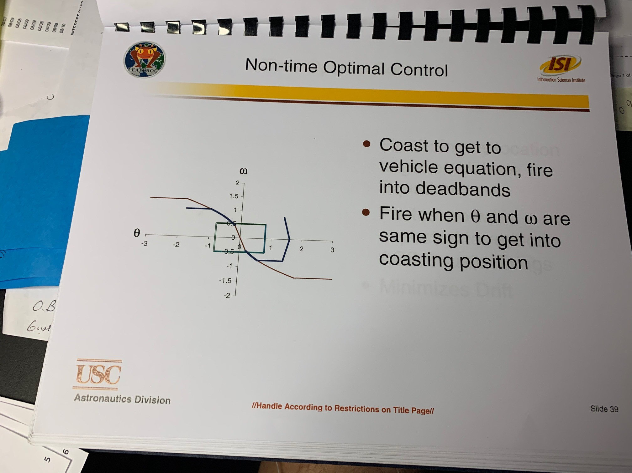
ACS Schematic

Slide 52
Software Discussion
Safety and Abort Plans
Validation Tests planned for Software functions (nominal and abort)
Ground Control Code Plan
Flight Operations Scheduler

Slide 53
Software Details- Safety and Abort Clauses
Safety and Abort Clauses
  Three classes of Abort Commands
    Subsystem Test Terminate
To abort an individual subsystem preflight test. The test is aborted as soon as possible (based on preservation of system).
    Mission Abort Command
In this class, a vehicle can be either sent an Abort Command from Ground, or the GNC can decide that it needs to Abort.
The vehicle aborts the normal profile navigation, the attitude is fixed to normal, and the engine goes to AbortRPM.
    Mission Emergency Abort
In this mode all operations are suspended immediately, including shut down of all Thrusters and emergency shutdown of the Jet Engine.

Slide 54
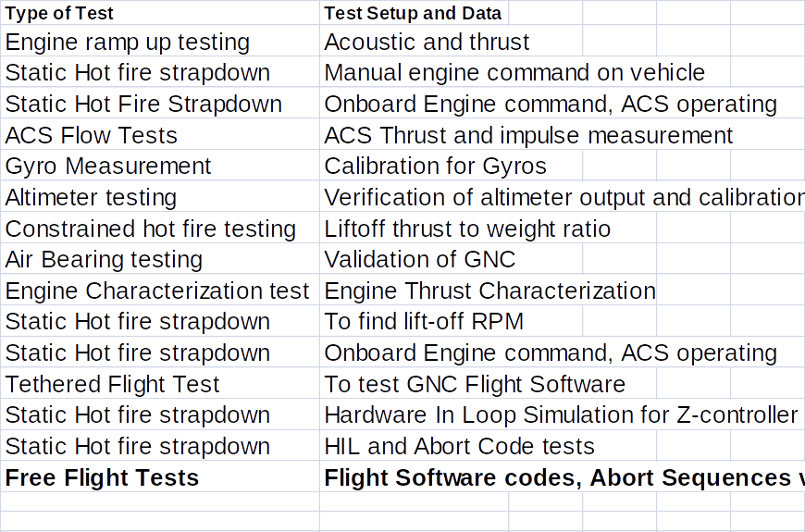
Initial Test Validation Matrix for Software and Avionics Control

Slide 55
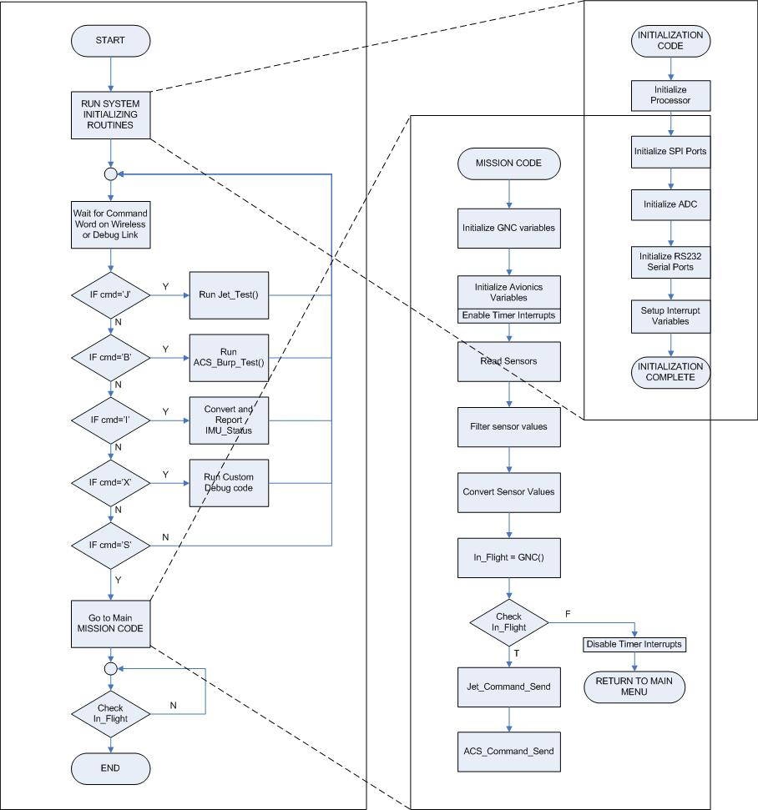
Software Architecture Pseudo-Code Diagram

Slide 56
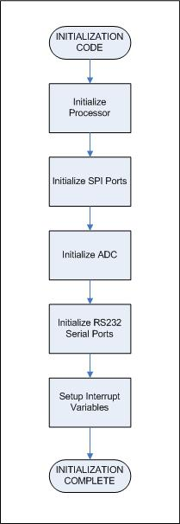
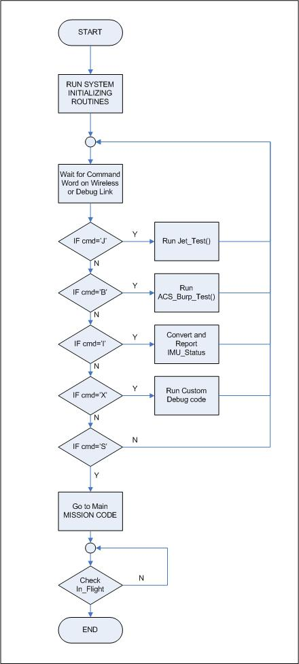
Software Architecture (cont.)
Mission Code
Initialize GNC variables
Initialize Avionics Variables
Enable Timer Interrupts
Read Sensors
Convert Sensor Values
In_Flight = GNC_Luna()
Check In_Flight
Disable Timer Interrupts
Jet_Send
RETURN TO MAIN MENU
ACS_Send

Slide 57
Ground Command Abort Sequences
Command/Auto | Command Pressed/Reason | Effect on Engine | Effect on controller | Effect on ACS
Emergency shutdown/ | D/ | Full shut off | None | Shutoff
Engine Idle/ | C/ | Idle | none | Off
Z toggle/ | Z/ | No change | Z controller removed, no effect on GNC | Stays On
Flight Abort/ | A/ | RPM fixed to value corresponding to thrust just below weight | Z-off, GNC is on | ACS is on
/D | Angle exceeded> +/-15degree | Full shut off | None | Shutoff
/A | Altitude > 6 m | RPM fixed to value | Z-off, GNC is on | Acs is on
/D | Flight time exceeded> t secs | Full shut off | None | Shutoff

Slide 58
Fault Probabilities and Scenarios
Scenarios | Reason | Problems | Abort Sequence
Flight above 6 meters | Manual; engine keeps firing | Escapes net boundary | Flight Abort
Flight time > t seconds | Manual; engine keeps firing | Overheating | Emergency
Roll, Pitch > +/-15 degrees | Wind; misfiring thrusters; altimeter misreading | Tips over | Emergency
Rabbit Dies | Electrical misfires; batteries die | Controls inputs; engine may still fire | Emergency
Engine Fails | Air in fuel; electrical misfire; pump malfunction; dust | Coughs; fire damage; stalls completely | Flight Abort or Emergency
Altitude Control System | Batteries die; wires disconnect | Stabilizing thrusters won't work properly | Flight Abort
Z-controller Fails | Altimeter misreading; disconnection | Begins rotating irrationally | Flight Abort
Ground Comp Malfunctions/Dies | Battery; Bluetooth malfunction | Craft is running on auto | No sequence
Power Fails Non-uniformly | Batteries die; wires disconnect | See Rabbit, Engine, Controller dies | Flight Abort or Emergency
Power Fails Uniformly | Batteries die; wires disconnect | Machine drops to ground as engine stops | Flight Abort or Emergency

Slide 59
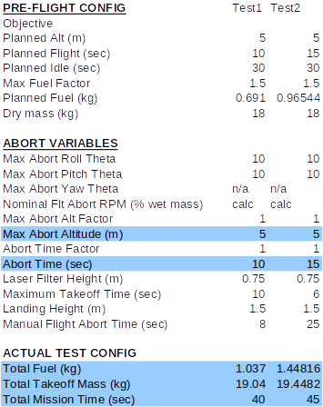
Abort and Mission Variables would be programmed into onboard Avionics prior to flight

Slide 60
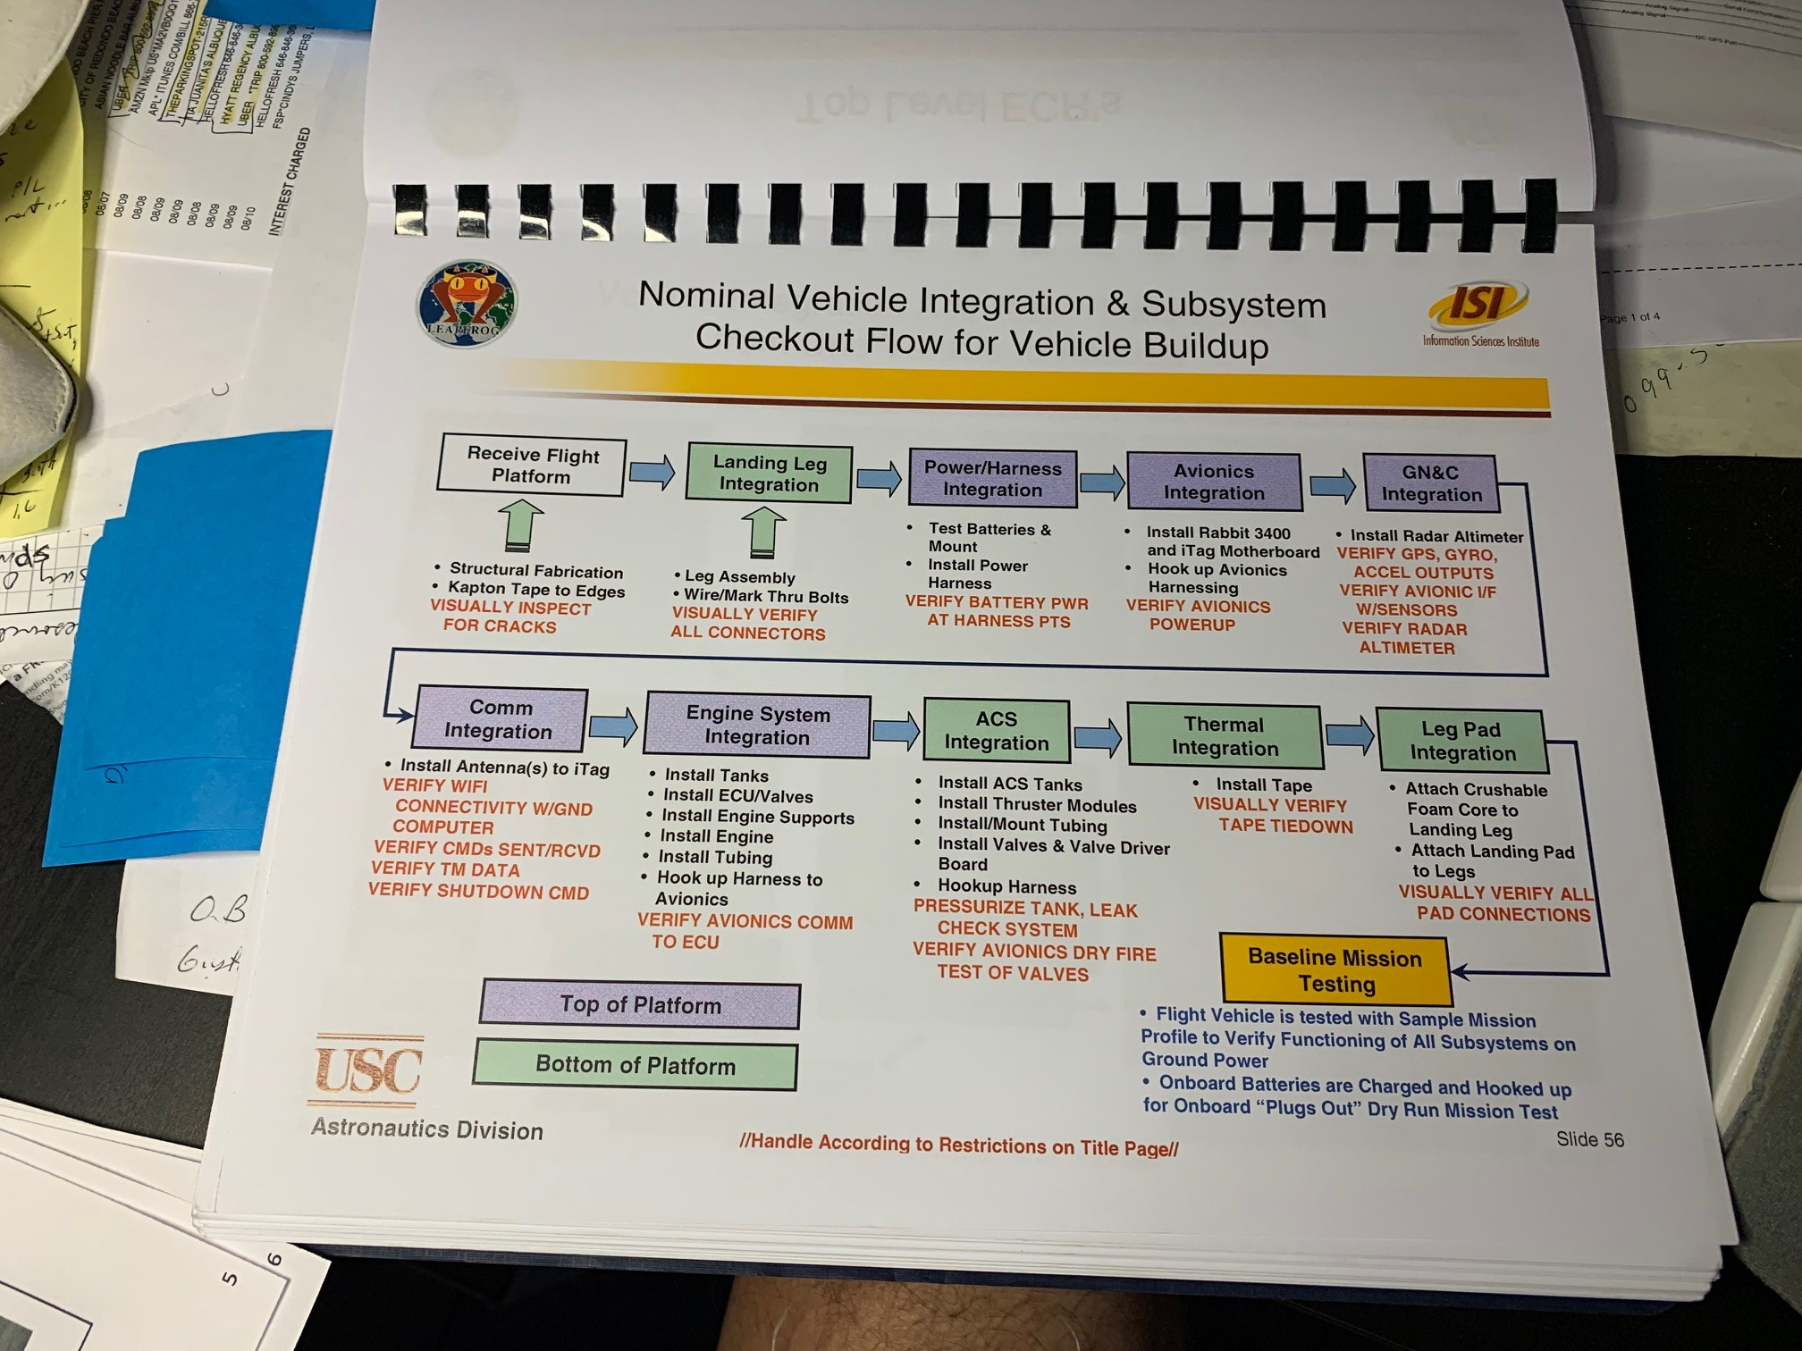
Show a simple intrgation and build and test flow

Slide 61
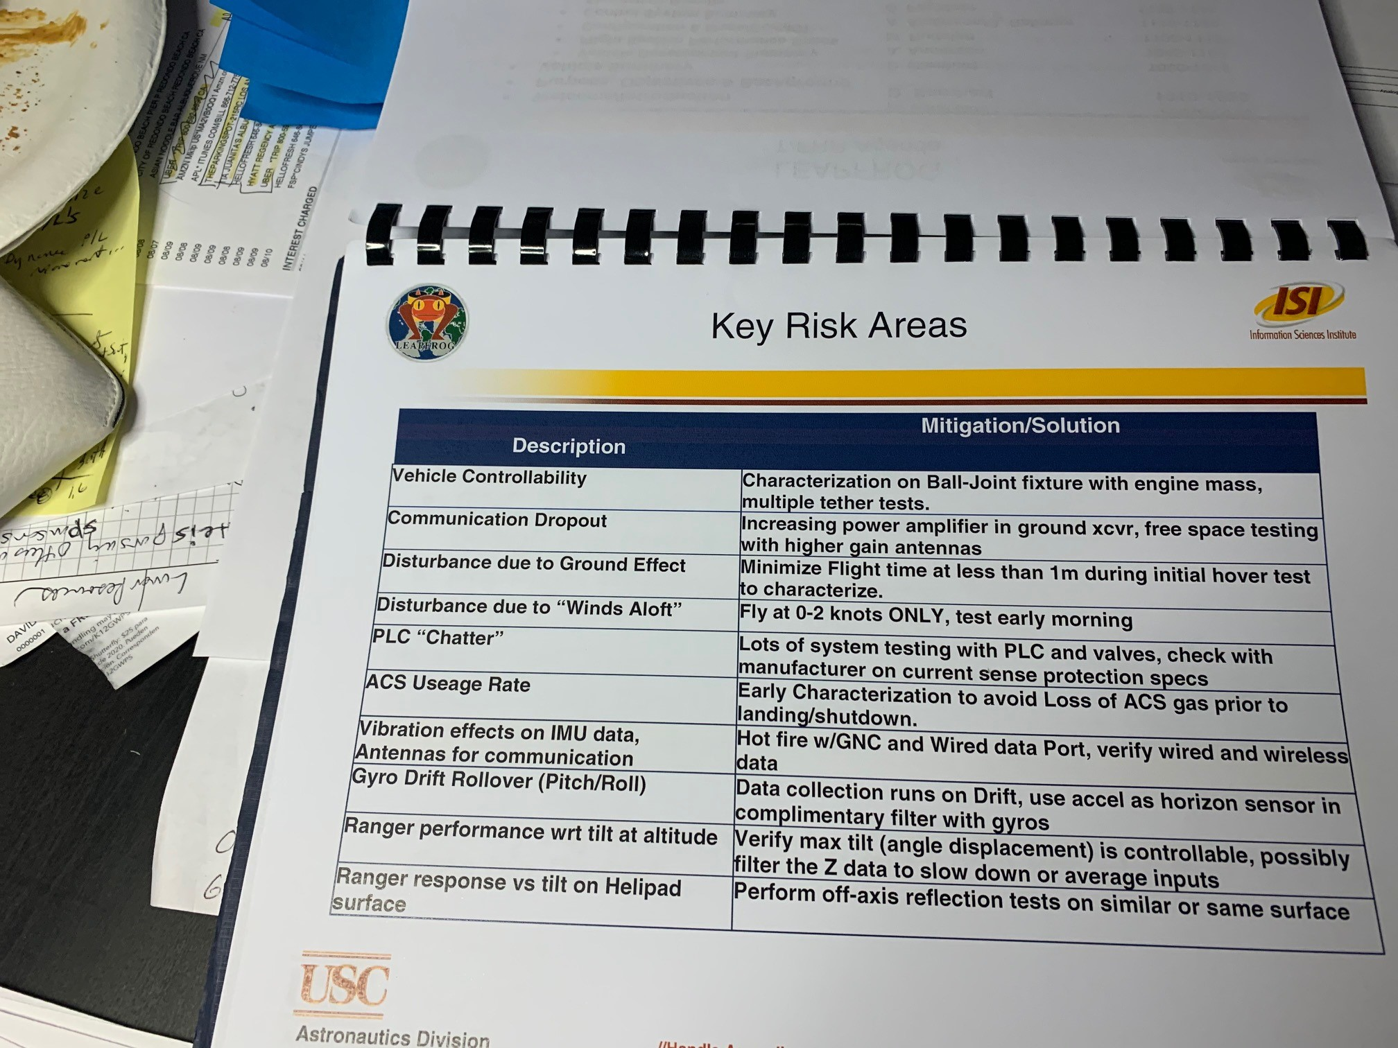
Need to identify key risk areas and show we are mitigating them.

